Slide 1
Learning objective:
5.1: 我吃米饭 wǒ chī mǐ fàn
★ To talk about what kind of food you like/dislike to eat.

Slide 2
New words
xǐ huān
喜欢
like
dislike
bù xǐ huān
不喜欢

Slide 3
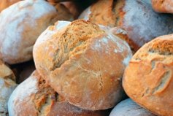
Sentence Pattern
我 + 喜欢/不喜欢 + 吃 + food
For example:
Wǒ xǐ huān chī
我喜欢吃
miàn bāo
面包。

Slide 4
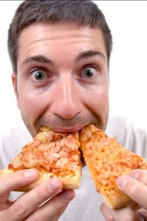
他喜欢吃比萨饼 Tā xǐhuan chī bǐsàbǐng

Slide 5
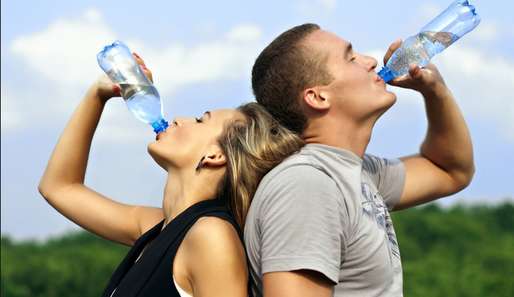
他们喜欢喝水 Tāmen xǐhuan hē shuǐ

Slide 6
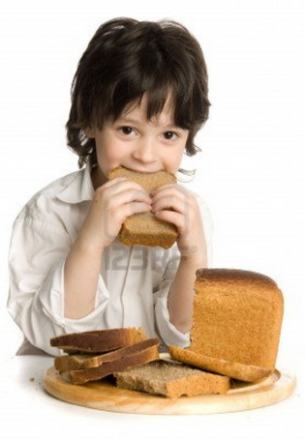
他喜欢吃面包 Tā xǐhuan chī miànbāo

Slide 7
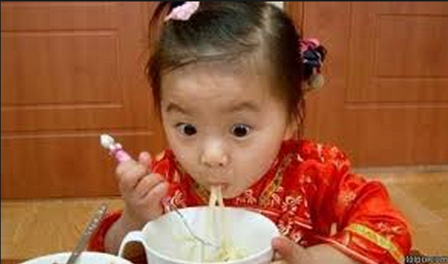
她喜欢吃面条 Tā xǐhuan chī miàntiáo

Slide 8
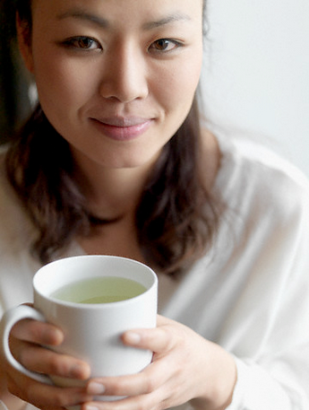
她喜欢喝茶 Tā xǐhuan hē chá

Slide 9
听 Listen and complete the table below with English.
名字/ Name | 喜欢 | 不喜欢
Xiaoli | e.g. rice
Fan fan
Sam
Lily

Slide 10
听-answer
名字/ Name | 喜欢 | 不喜欢
Xiaoli | rice | eggs
Fan fan | juice | water
Sam | pizza | boiled rice
Lily | noodles | bread

Slide 13
茶

Slide 14
水

Slide 15
果汁

Slide 16
面包

Slide 17
比萨饼

Slide 18
水果

Slide 19
面条

Slide 20
鸡蛋

Slide 21
米饭

Slide 22
面条
茶
米饭
面包
水
比萨饼
水果
鸡蛋
果汁

Slide 23
读
Xiaoming likes eating bread
Luke eats noodles with his older brother
Luke does not like drinking fruit juice
Elena is 47 years old
Elena likes sport
Elena’s least favourite food is pizza
What does Xiaoming’s Dad not like to drink?
A: Tea
What does Luke not eat?
A: Rice
What food does Elena like to eat
A:Fruit

Slide 24
读 extension answers
Where do you think Elena is from? Can you guess the name of Germany in Chinese?
She is from France (法国) – fǎguó . Germany is 德国 (déguó )
Order the three people in terms of who you think is the healthiest. Give reasons for your choices.
Healthiest: Elena. She exercises two days per week, eats fruit, does not eat pizza and drinks water.
Middle: Xiaoming: She does not eat pizza, but only exercises one day per week.
Least healthy: Luke. He eats pizza and does not like fruit juice. He does not like playing sport, preferring to surf the internet and read books.

Slide 25
面条
茶
米饭
面包
水
比萨饼
水果
鸡蛋
果汁

Slide 26
Answers
（一） 茶 chá
（二） 比萨饼 bǐsàbǐng
（三） 鸡蛋 jīdàn
（四） 米饭 mǐfàn
（五） 面条 miàntiáo
（六） 面包 miànbāo
（七） 水 shuǐ
（八）水果 shuǐguǒ
（九）果汁 guǒzhī

Slide 27
http://www.bbc.co.uk/languages/chinese/real_chinese/videos/drinks/

Slide 28
听-support
a) 3 b)2 c)4
a) March 4th b) April 3rd c) April 4th
a) eggs, rice b) noodles, water c) eggs, tea
a) June 6th b) September 9th c) June 9th
a) Rice, Fruit b) Fruit, water c) Rice, juice
a) His brother b) His cat c) His Dad

Slide 29
面条
茶
米饭
面包
水
比萨饼
水果
鸡蛋
果汁

Slide 30
Practice each character at least 5 times:
jī
miàn
dàn
tiáo
mǐ
bāo
chá
guǒ
Extension 1: Test your memory: cover, write, check.
Extension 2: write a word that contains each character. For example, for 你, you would write 你好.

Slide 32
Aims
To learn the radicals for the characters we have been learning
To recap the six vocabulary items for this week
To practice reading and writing skills using this vocabulary

Slide 33
Match the radicals to form characters
1 氵
2 饣
3 口
4 田
5 火
6 又
7 虫
a) 少饭
炒饭
水果
b) 水木
c) 果十
果汁
d) 曷
喝
e) 鸟蛋
鸡蛋
f) 交子
饺子
g) 鸡疋
鸡蛋
h) 力非
咖啡
Do you know what the radicals mean?

Slide 34
口

Slide 35
饣

Slide 36
氵

Slide 37
田

Slide 38
火

Slide 39
又

Slide 40
虫

Slide 41
Aims
To learn the radicals for the characters we have been learning
To recap the six vocabulary items for this week
To practice reading and writing skills using this vocabulary

Slide 42
咖啡

Slide 43
包子

Slide 44
饺子

Slide 45
炒饭

Slide 46
炒面

Slide 47
蛋炒饭

Slide 48
Aims
To learn the radicals for the characters we have been learning
To recap the six vocabulary items for this week
To practice reading and writing skills using this vocabulary

Slide 49
Reading answers
Three people: Her mum, her dad, and Xiaoli
Dad: 46, Mum: 38, Xiaoli: 12
Rice, steamed stuffed bun, Chinese dumplings, Chinese tea
Dad does not like bread and water
December 24th
Her cat likes eating pizza

Slide 50
Practice each character at least 5 times:
xǐ
huān
yě
hē
chī
zuì
Extension 1: Test your memory: cover, write, check.
Extension 2: write a word or phrase that contains each character. For example, for 你, you would write 你好.

Slide 51
Writing answers
1. 小莉不喜欢吃面包，也不喜欢喝水。她喜欢吃米饭。
2. 我爸爸不喜欢吃炒面。他最喜欢吃炒饭。
3. 我最不喜欢吃饺子，我最喜欢吃包子。我喜欢喝咖啡，也喜欢吃米饭。

Slide 52
Aims
To learn the radicals for the characters we have been learning
To recap the six vocabulary items for this week
To practice reading and writing skills using this vocabulary

Slide 53
口
Which characters does this radical belong to? One point if you can say it, two points if you can say it and write it!

Slide 54
饣
Which characters does this radical belong to? One point if you can say it, two points if you can say it and write it!

Slide 55
Which characters does this radical belong to? One point if you can say it, two points if you can say it and write it!
氵

Slide 56
Which characters does this radical belong to? One point if you can say it, two points if you can say it and write it!
田

Slide 57
Which characters does this radical belong to? One point if you can say it, two points if you can say it and write it!
火

Slide 58
Which characters does this radical belong to? One point if you can say it, two points if you can say it and write it!
又

Slide 59
Which characters does this radical belong to? One point if you can say it, two points if you can say it and write it!
虫

Slide 60
Which characters do these radicals belong to? One point if you can say it, two points if you can say it and write it!
口
氵
饣
田
火
艹
又
虫

