Slide 2
China… or not?

Slide 3
Rules
In your teams look at the pictures and decide if they are in China or not.
Number each slide and put a tick or cross to indicate whether the scene is in China or not.
Your team will get a bonus point if you can also name the location of the photo.

Slide 4
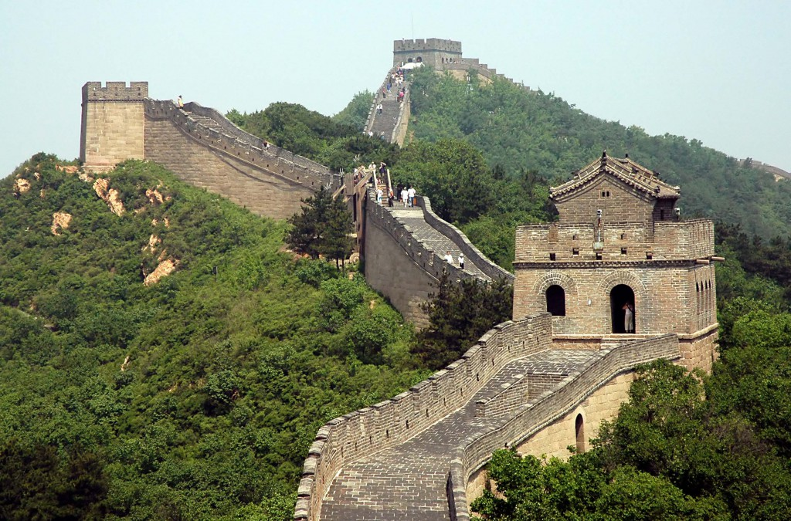
Example

Slide 5
Example
China!
The Great Wall of China

Slide 6
1

Slide 7
2

Slide 8
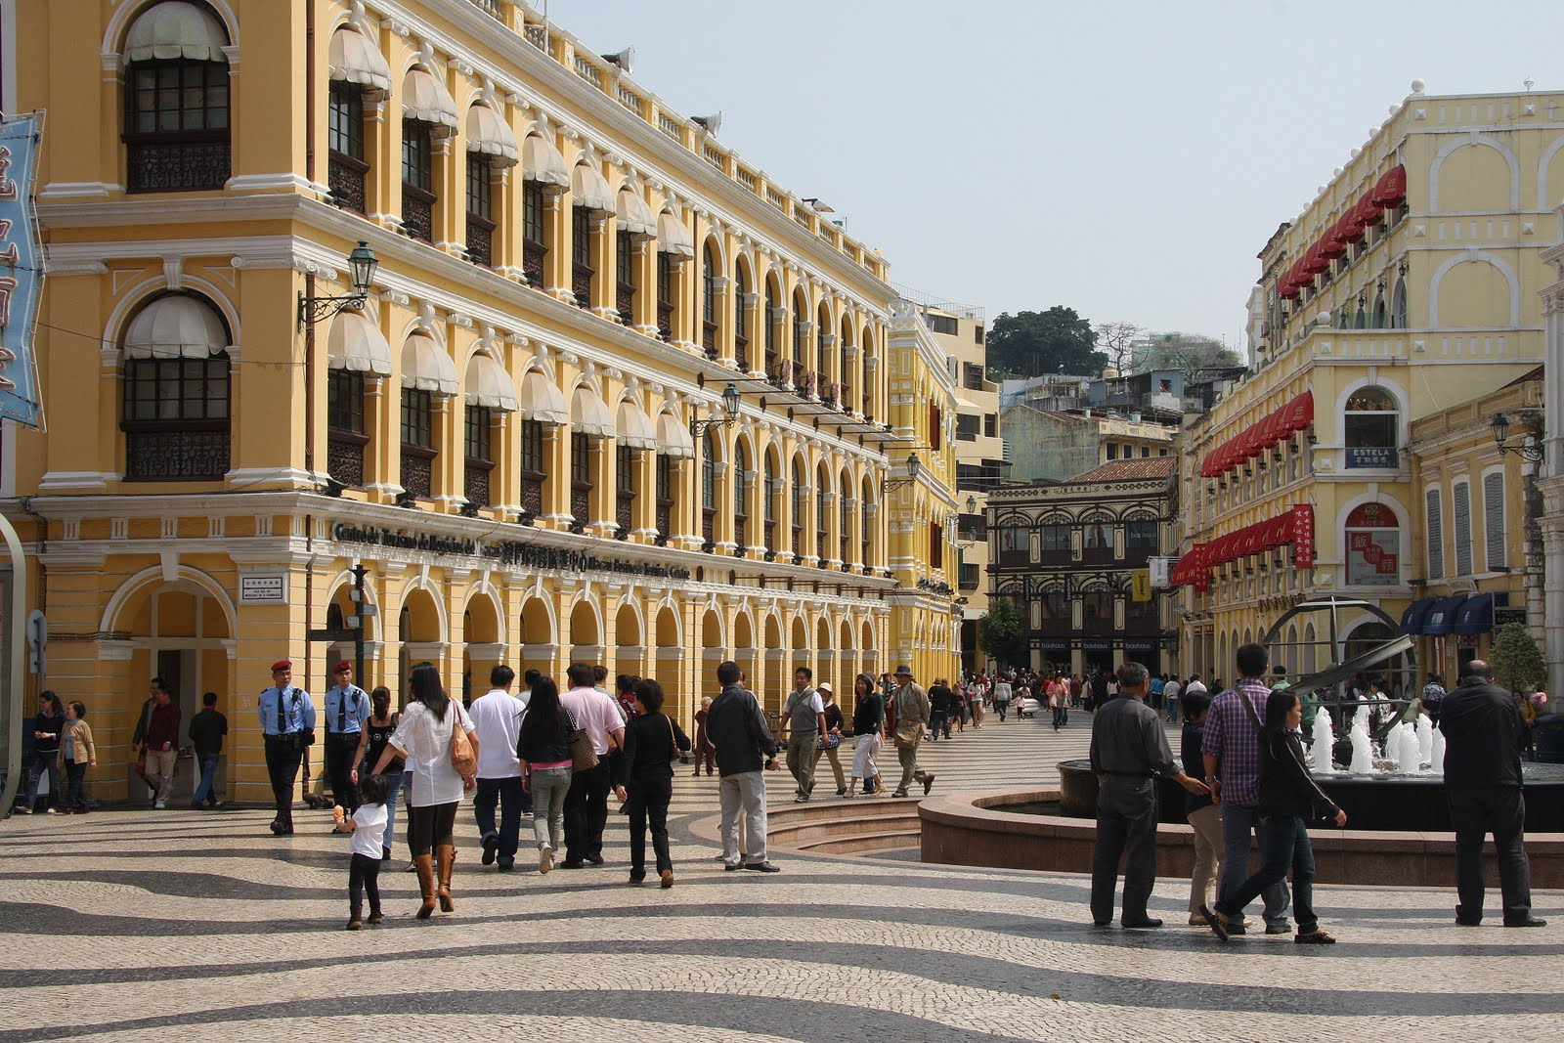
3

Slide 9
4

Slide 10
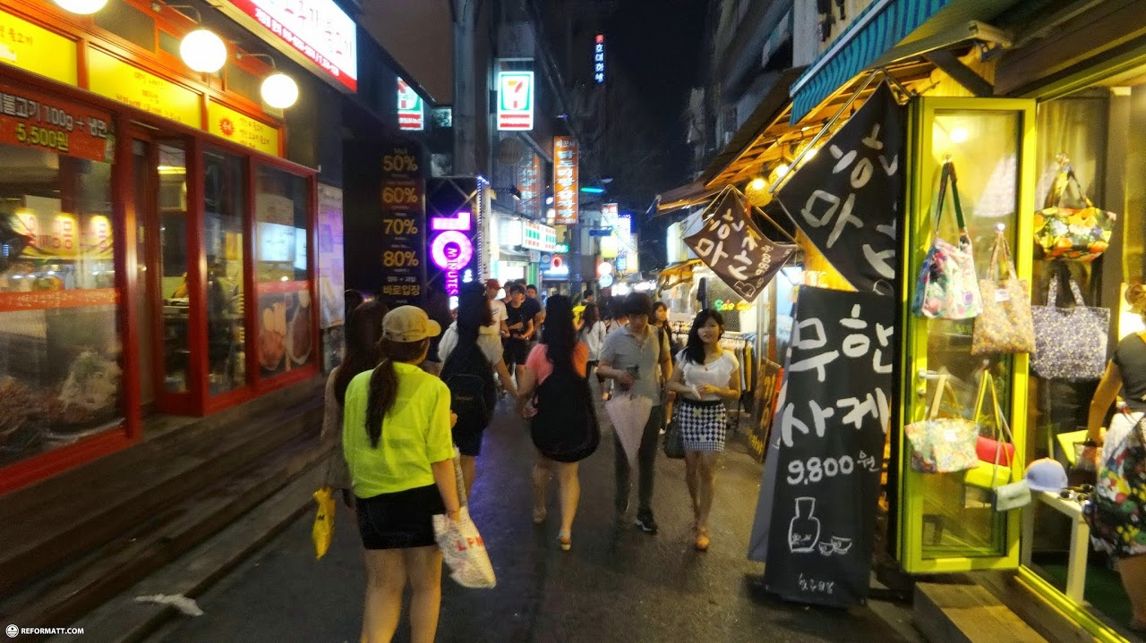
5

Slide 11
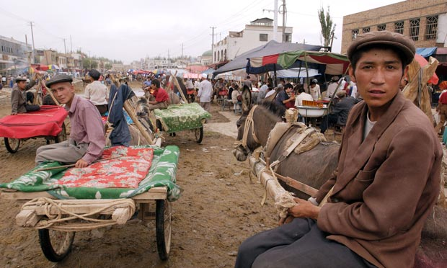
6

Slide 12
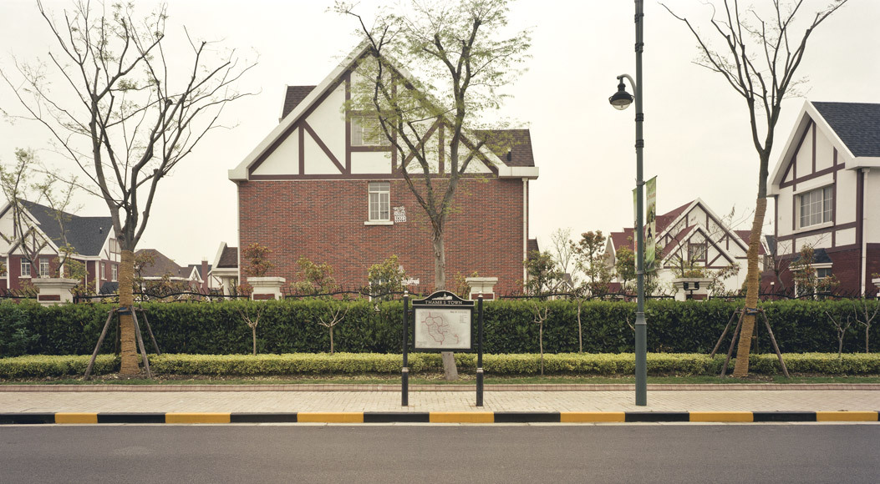
7

Slide 13
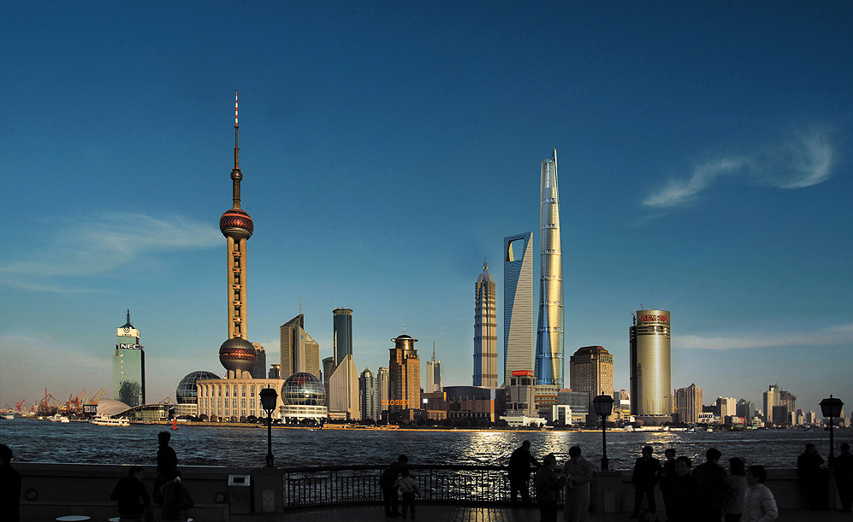
8

Slide 14
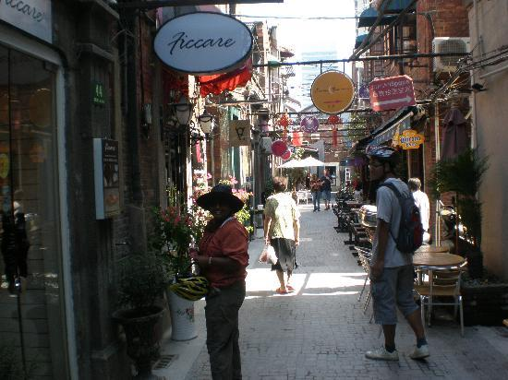
9

Slide 15
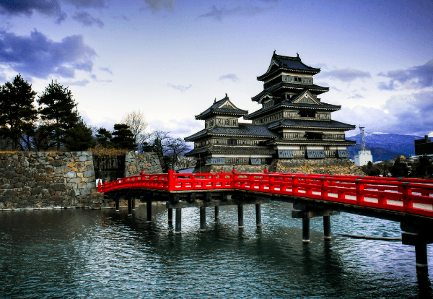
10

Slide 16
Answers
Swap your papers with another team and mark them as we go.
You get one point for knowing whether the picture was in China or not and one point if the name of the location is correct (for pictures which are not China just the name of the country will do).

Slide 17
1
China!
The Forbidden City, Beijing

Slide 18
2
China!
St Sofia Church, Harbin

Slide 19
3
China!
Macau

Slide 20
4
NOT China!
Mount Fuji, Japan

Slide 21
5
NOT China!
Seoul City, Korea

Slide 22
6
China!
Kashgar, Xinjiang

Slide 23
7
China!
Thames Town, Shanghai

Slide 24
8
China!
Shanghai

Slide 25
9
China!
The French Concession, Shanghai

Slide 26
10
NOT China!
Matsumoto Castle, Japan

Slide 27
How did you do?
What did you know?
What surprised you?

