Slide 1
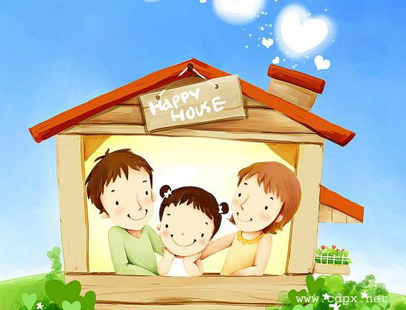
Lesson 12
jiā
家
family
rén
人
members

Slide 2
Learning objectives:
To use "I have? I don't have" about the family.

Slide 3
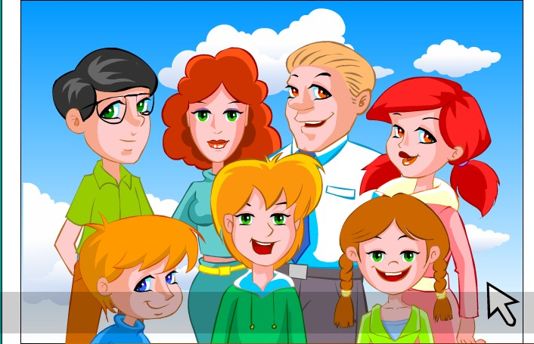
māma
妈妈
bàba
爸爸
jiě jie
姐姐
ɡē ɡe
哥哥
dì di弟弟
我
mèi mei妹妹

Slide 4
Match Up
哥哥
姐姐
妈妈
妹妹
弟弟
爸爸
Father
Mother
Older brother
Younger brother
Older sister
Younger sister

Slide 5
Listen to Groovy Paulie and friends.
How do you say " have" and "not have"?
哥哥
姐姐
妈妈
妹妹
弟弟
爸爸
to have
有
yǒu
not to have
没有
méi yǒu

Slide 6
____ 和 ____

Slide 7
Sentence pattern:
yǒu méi yǒu
有 / 没有
to have not to have
我+有/没有 + family members
Notes:
22

Slide 8
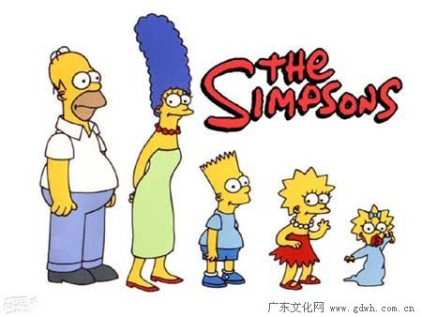
Practice
我
Example:
我有爸爸。 I have a father.
我没有弟弟。I haven’t any little brothers.

Slide 9
New words
hé
和
and

