Slide 1
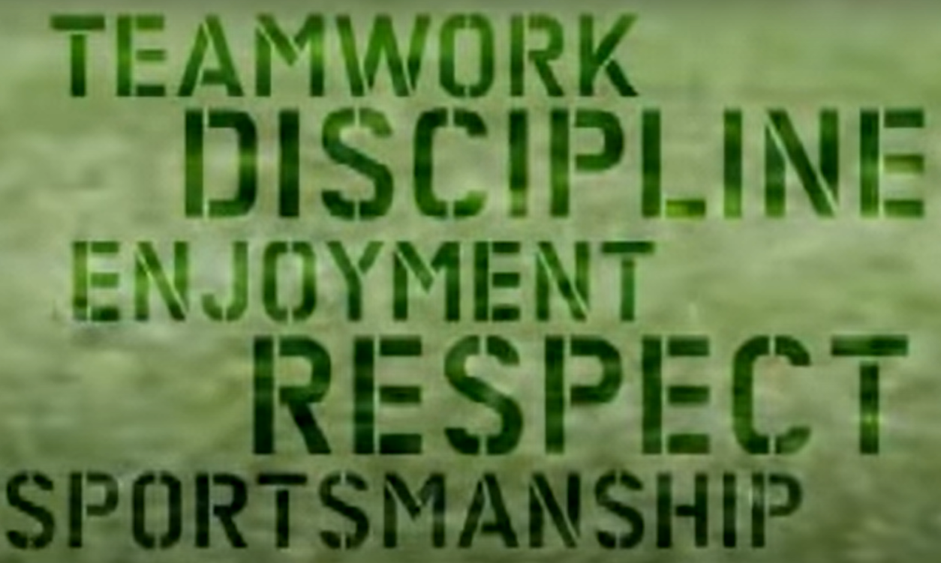
Discussion: What do rugby’s core values mean to you?

Slide 2
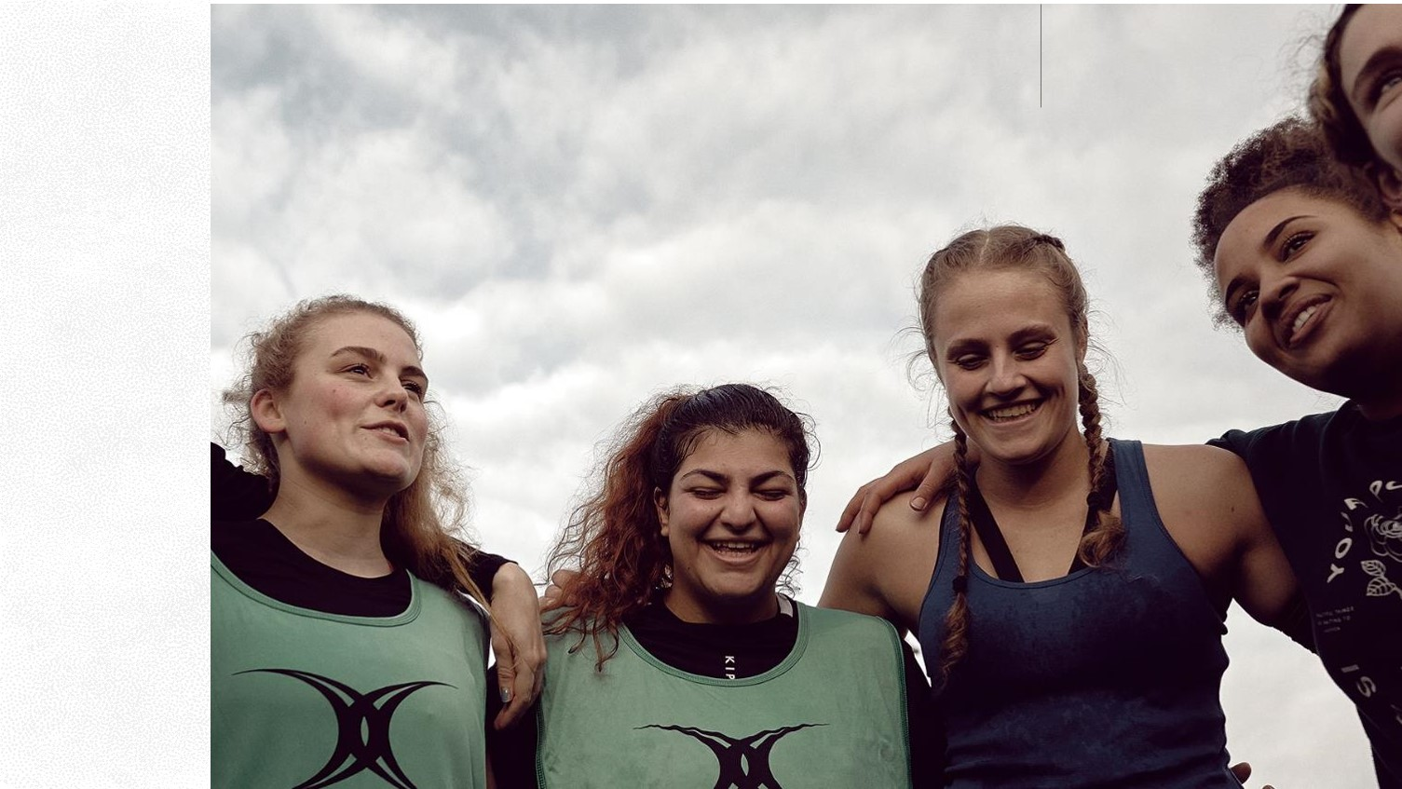
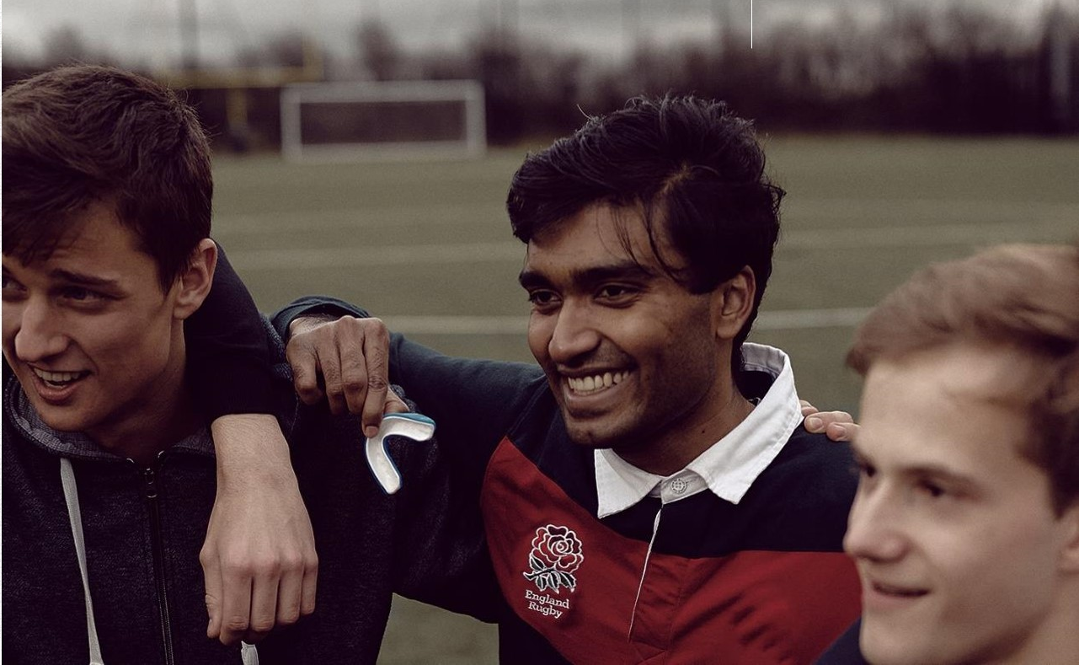
Discussion: What do rugby’s core values mean to you?
Rugby’s values are:
Teamwork
Respect
Enjoyment
Discipline
Sportsmanship
They are what makes the game special for those who enjoy the way rugby is played and supported.
Every player and coach is expected to follow these values.
Do you think having a set of values that players can follow is important?
Why?
Players represent their sport, their team and, sometimes, their country. They set an example to supporters, who will hopefully follow the core values too.

Slide 3
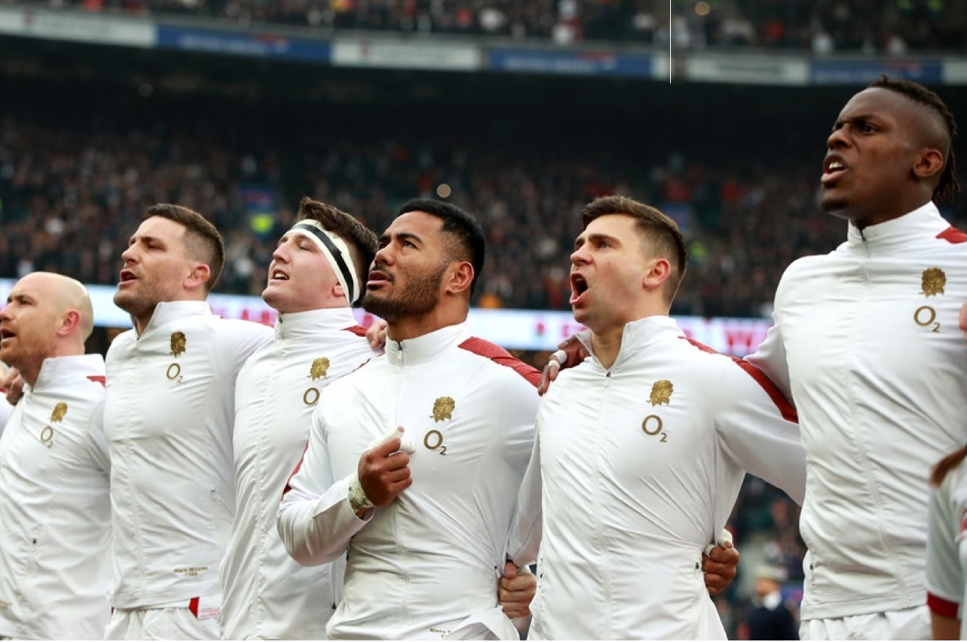
Discussion: What does TEAMWORK mean?
Teamwork is very important.
It includes:
Welcoming all new team members, no matter what they look like or where they come from
Not being selfish and working for the team, not for ourselves alone, both on and off the field
Knowing that each player has a part to play
Not only passing to your friend and including players of all abilities
Speaking out if your team or sport is threatened by bad words or actions
Example for discussion:
Yusef is playing in his first game of rugby and is not being passed the ball and he is looking sad. Joe is the best player and always scores lots of points so your teammates often try to pass the ball to him so that they can win. How can you ensure that Yusef enjoys the game? Why is it important that he enjoys the game? Is winning the game more important than Yusef enjoying the experience?

Slide 4
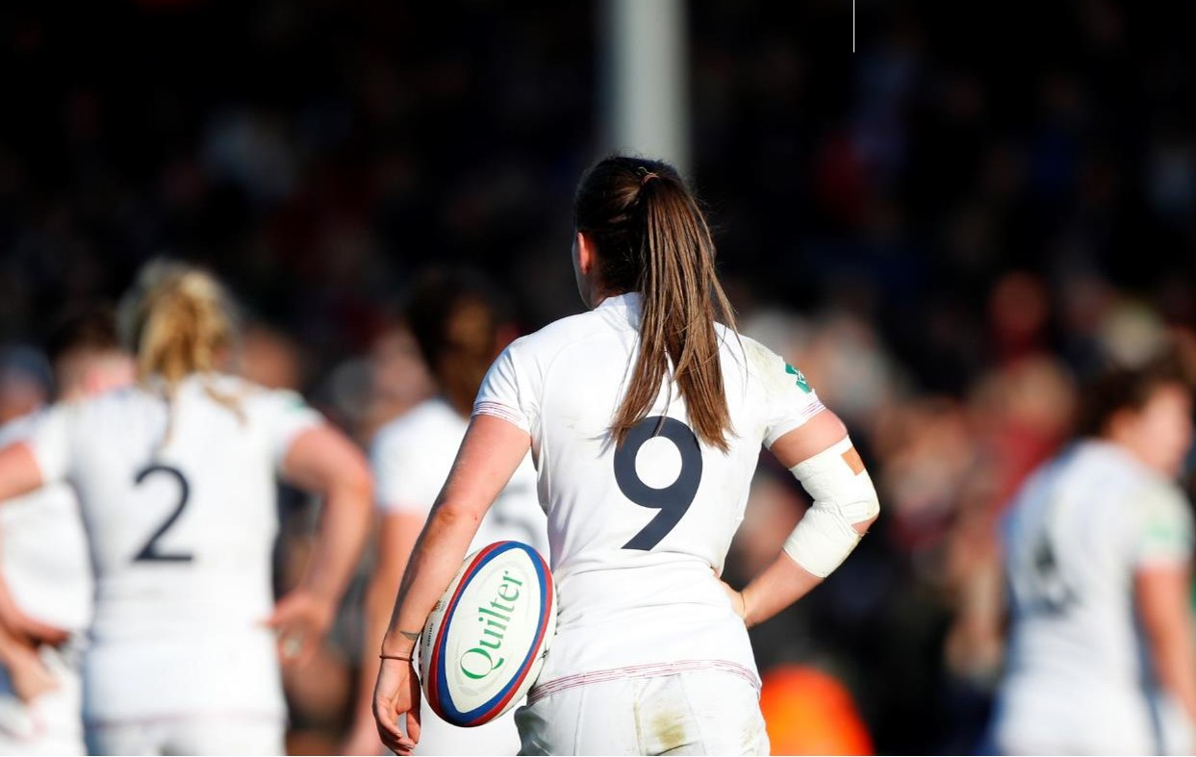
Discussion: What does RESPECT mean?
Showing respect to others and feeling respected ourselves, is always important.
We earn the respect of others in the way we behave
We are polite and respect our referees. We accept their decisions, even if we think they have made a mistake.
We show respect to opposition players and supporters and are friendly and polite to them even when we lose.
We show our appreciation to our coaches and those who run our clubs and treat the grounds, school and clubhouses with care
Example for discussion:
Lucy is playing really well. It's an exciting match and right at the end, she scores the winning try. The referee says that there has been a foul and says, ‘No try!’ Lucy believes that the referee has made a mistake. Her teammates agree with her. The decision means that Lucy’s team loses the match!
She and her team can’t believe it. What should they do?

Slide 5
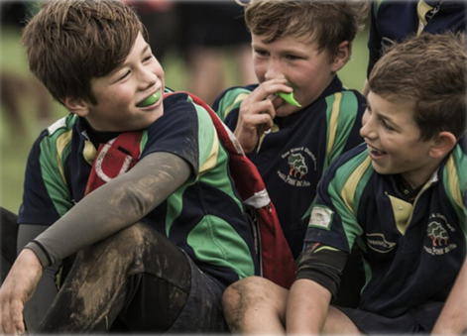
Discussion: What does ENJOYMENT mean?
We play sport because we enjoy it.
In rugby union, when we play and support, we believe that:
Everyone should be able to enjoy playing and training. We will not ruin it for others
We do not try to win at all costs
We play to be healthy, learn new skills and we enjoy being with friends as well as making new friends
We enjoy being part of a team
Doing well and showing improvement in our health and skills is satisfying
Example for discussion:
Danny looks forward to playing in matches, but he doesn’t enjoy training. When he goes to training sessions, he makes jokes when the coach is talking and doesn’t try very hard when skills are being practised. Ben trains hard but doesn’t always get picked for the team, but Danny always plays because he is fast. What should Ben do? What should his coach do?

Slide 6
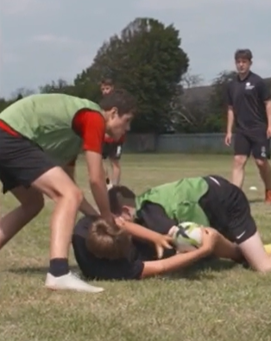
Discussion: What does DISCIPLINE mean?
When playing rugby with tackling, tag rugby or touch rugby, we are honest and fair.
We obey the laws of the game which means that everyone enjoys themselves
The laws of the game ensure that everyone can be safe
Example for discussion:
Why are rules important?
What rules do you think are the most important?
What would happen if there were no rules in sport?
What would happen if there were no rules at school and people could do whatever they wanted, whenever they wanted?
Is it important to have punishments for people who break the rules?

Slide 7
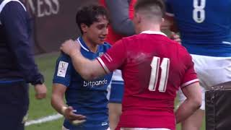
Discussion: What does SPORTSMANSHIP mean?
When we talk of sportsmanship we mean:
Playing to win but not at all costs
Being friendly to the opposition before, during and after the game
Being generous with our praise for the opposition whether we win or lose
We encourage our teammates even if things are not going well
Supporters offer encouragement and don’t criticise players
We always thank the referee and coaches
Example for discussion:
At the end of their match, Anaya’s team celebrates because they have won by lots of points. They jump up and down with excitement. Anaya sticks her tongue out and makes rude faces at the opposition who are very sad after they have been beaten so heavily.
How could Anaya act in a more sporting way to the opposition at the end of the match?

