Slide 1
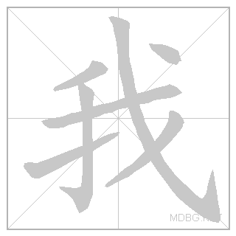
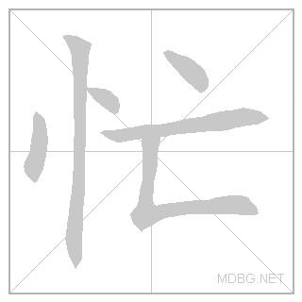
2.1: 我的家人 wǒ de jiā rén
Institute of Education
IOE Confucius Institute for Schools
以
前
学
过
的
汉
字
My family
Jinbu 1
Chapter 2, Unit 1
In this lesson you will Learn the words for members of family
Talk about what family members you do and don’t have
Adapted from lessons donated by colleagues at Dartford Grammar School
wǒ
suì
hěn
máng
Can you add the English? Can you use them in a sentence?

Slide 2
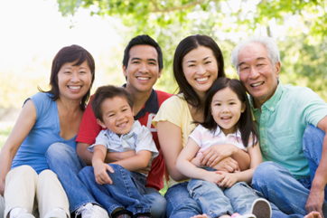
wǒ jiā
我家
my family

Slide 3
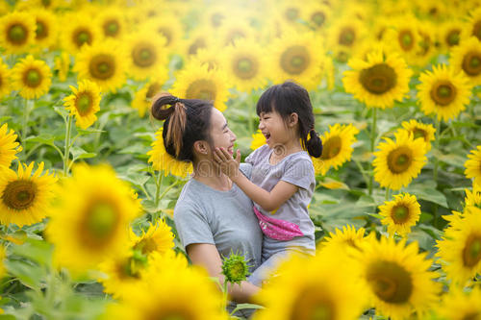
mā ma
妈妈
mother

Slide 4
bà ba
爸爸
father

Slide 5
jiě jie
姐姐
elder sister

Slide 6
mèi mei
妹妹
younger sister

Slide 7
gē ge
哥哥
elder brother

Slide 8
dì di
弟弟
younger brother

Slide 9
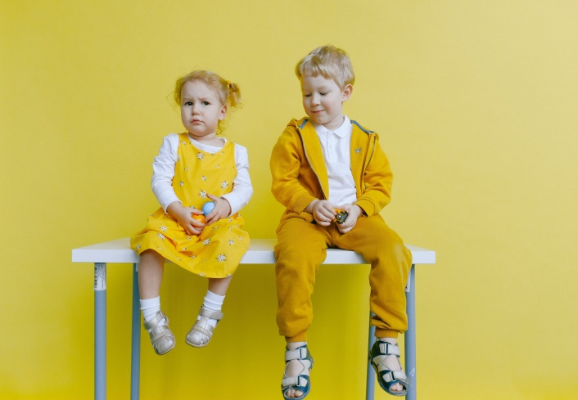
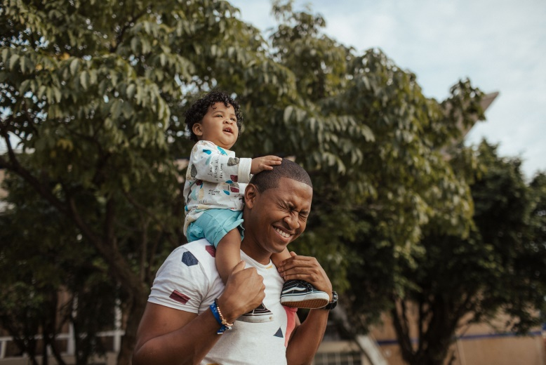
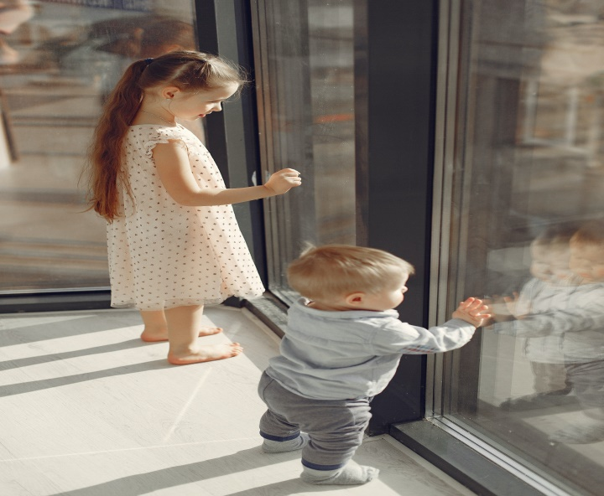
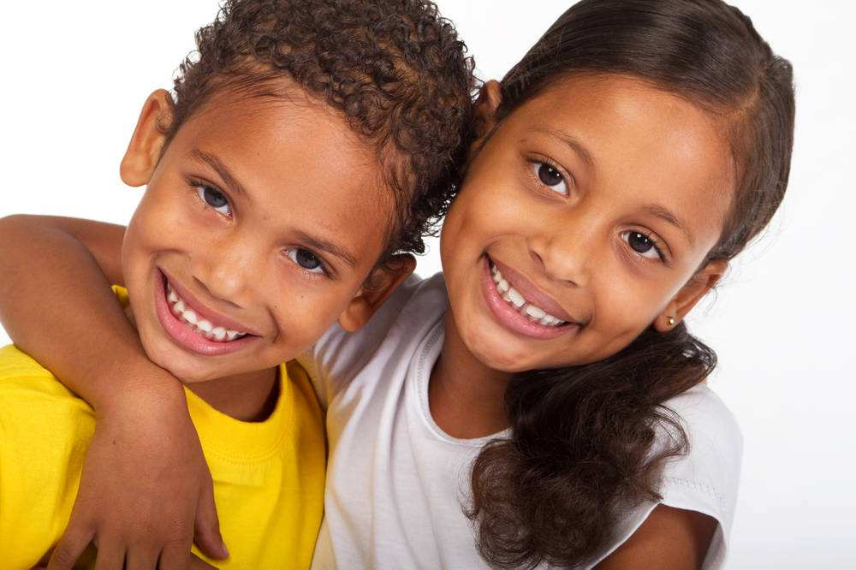
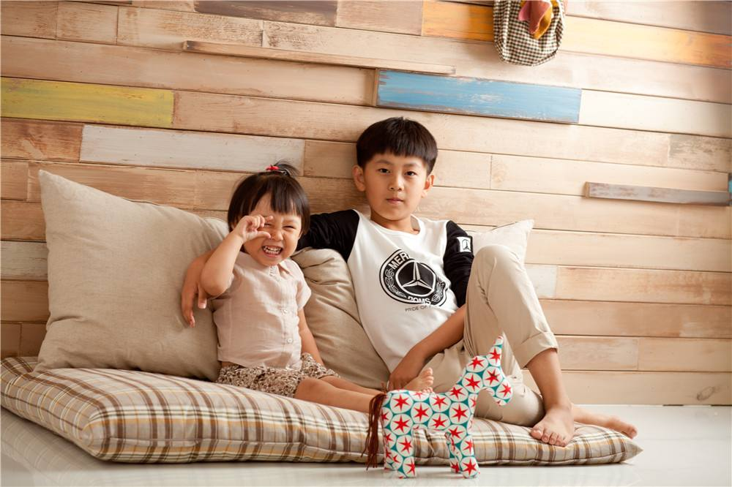

Slide 10
Practice each character at least 5 times:
mèi​mei​
mā​ma​
jiě​jie​
bà​ba​
gē​ge​
dì​di​
Extension 1: Test your memory: cover, write, check. Extension 2: write a word that contains each character. For example, for 你, you would write 你好.

Slide 11
Game time!

Slide 12
Ping-Pong(Speaking)
Two students in a pair
One student read words in blue the other read in black ( student 1 : 妈妈，student 2: 爸爸， student 1: 姐姐，student2：妹妹， student 1 : 哥哥……)
Teacher use timers to see which pair can finish all the words, the quickest pair wins

Slide 13
妈妈 | 爸爸 | 姐姐 | 妹妹
哥哥 | 弟弟 | 不忙 | 很忙
很好 | 早上 | 老师 | 我家

