Slide 1
ANTI-BULLYING WEEK 2023

Slide 2
Anti-Bullying Week 2023
Make A Noise About Bullying
Too often, we are silent when we see bullying take place, silent about the hurt bullying causes, and silent when we hear bullying dismissed as ‘just banter’.
Together, we can make a difference and take a stand against bullying.
From the playground to Parliament, and from our phones to our homes, let’s make a noise about bullying.
It doesn't have to be this way.
Of course, we won’t like everyone, and we don’t always agree, but we can choose respect and unity.
This Anti-Bullying Week let’s come together to have discussions about what bullying means to us, how banter can turn into something more hurtful, and what we can do to stop bullying.

Slide 3
https://youtu.be/VkU2xYJKQq4

Slide 4
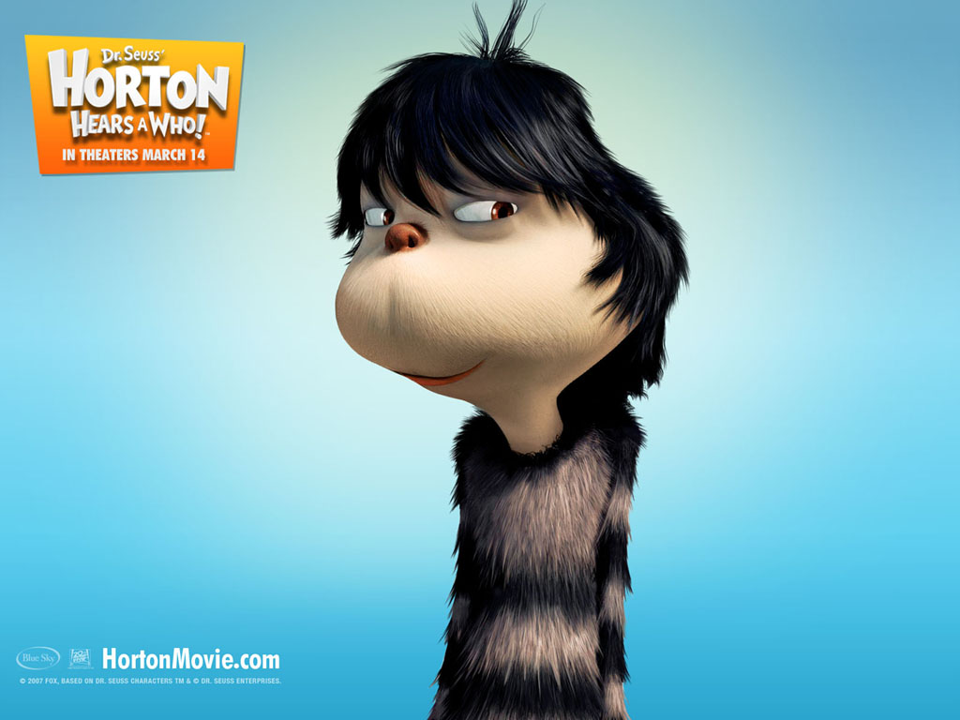
BE LIKE JO-JO
https://youtu.be/mur1iXhfJ5E

Slide 5
WHAT IS BANTER?
“
The playful and friendly exchange of teasing remarks.
“

Slide 6
“
WHAT IS BULLYING?
The repetitive, intentional hurting of one person or group by another person or group, where the relationship involves an imbalance of power. Bullying can be physical, verbal or psychological.
It can happen face to face or online.
“

Slide 7
Banter with friends can…
Make you feel closer to each other
Show acceptance in a friend group
Be a light-hearted and fun way to pass time
Show you trust each other

Slide 8
When banter becomes bullying…
Topic
Relationship
Where it happens
Repeated
Intention
Reaction

Slide 10
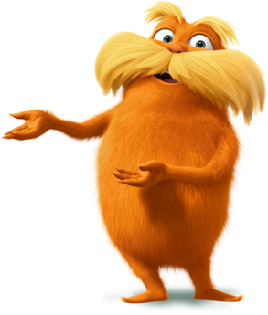
“
Unless someone like you cares a whole awful lot, nothing is going to get better. It’s not.
“
The Lorax
Dr. Seuss

