Slide 1
The 3 Pillars of Sikhism

Slide 2
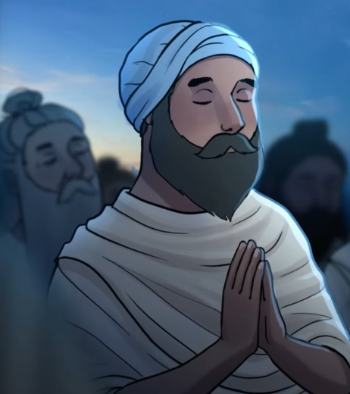
Naam Japna
This means ‘Repeating and remembering God's name.’
Sikhs believe you should always keep God in your heart and mind.
Nam Japna can be performed either silently (by repeating ‘Waheguru’ in the head) or aloud. Sikhs believe Naam Japna helps them to become less selfish (manmukh) and more God-centred (gurmukh).

Slide 3
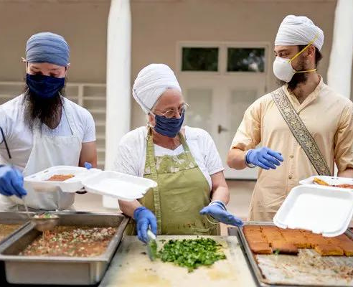
Kirat Karni
This means doing something honest, truthful and that will help others.
‘To work and earn by the sweat of the brow in a honest way, to live a family way of life, and practice truthfulness and honesty in all dealings’

Slide 4
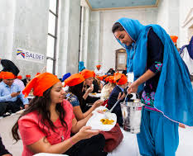
Vand Chhakna
This means to share the things you have.
Sikhs believe that if you are generous with others (particularly those less fortunate than yourself) it encourages compassion and love.
Sikhs believe that you should share food and eat it together to build community.

