Slide 1
The Dissolution of the Monastries
Tudor Crime and Punishment

Slide 2
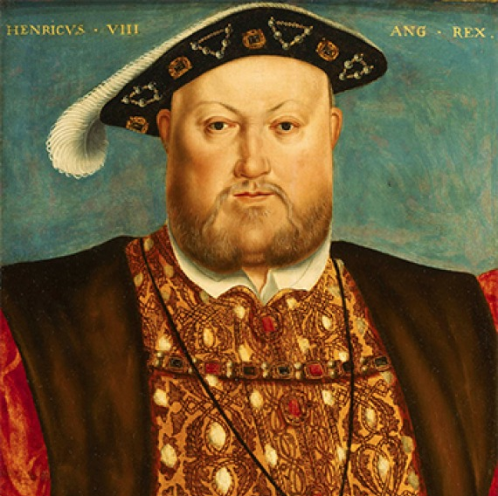
Split from Rome…
In the reign of Henry VIII the Pope was the head of all the Christian Church.
When the Pope refused to grant Henry VIII a divorce from Catherine of Aragon, he set up the Church of England. (The Roman Catholic faith believed in marriage for life. It did not recognise, let alone support, divorce.)
This is now known as the reformation.

Slide 3
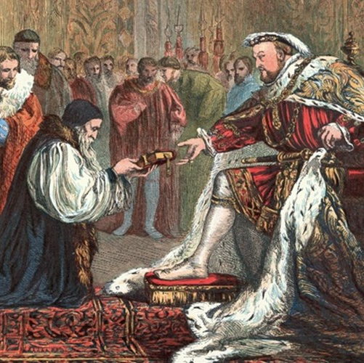
What was the reformation?
The Reformation was the process by which the English Church split off from the Roman church. Rather than the pope, the king became the spiritual head of the English church.
The word reformation is made from two Latin words:
re = "again"
and
formare = "to form or make“

Slide 4
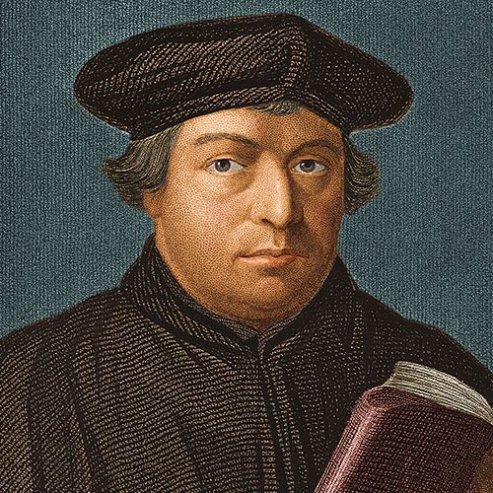
What was the reformation?
The English Reformation started in the reign of Henry VIII when he wanted to annul his marriage to Catherine of Aragon. However, the idea of reformation was started earlier by Martin Luther (1483-1546), a German monk.
Martin Luther began the Protestant Reformation, which lead to the birth of the Protestant faith. The Act of Supremacy (1534) confirmed the break from Rome, declaring Henry to be the Supreme Head of the Church of England.

Slide 5
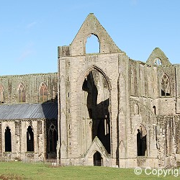
Dissolution of the Monastaries
The year 1536 saw Henry order the closing down of the wealthy Roman Catholic Abbeys, monasteries and convents across England, Wales and Ireland. This act became known as the 'Dissolution of the Monasteries’.
The Dissolution of the Monasteries lasted four years to 1540. The last monastery to be dissolved was Waltham Abbey in March 1540
Over 800 monasteries were dissolved, demolished for building materials, sold off or reclaimed as Anglican Churches.

Slide 6
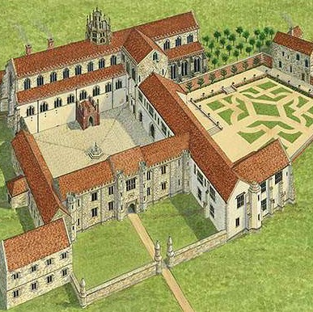
Role of the Monasteries
In Tudor times, monasteries played a significant role in aiding the poor and needy by providing alms, food, and shelter.
They offered charitable assistance, including healthcare and education, as well as serving as hubs for hospitality and employment.
Monasteries also provided a safety net for the vulnerable, offering support to widows, the elderly, and those with terminal illnesses.

Slide 7
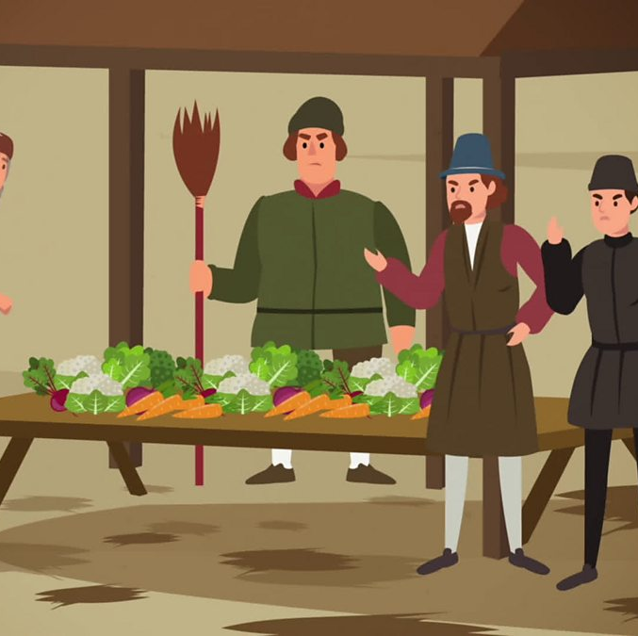
Increase in crime…
The dissolution of the Monasteries led to more crime. When the monasteries were shut, lots of poor people had nowhere to go and no one to help them. Many became homeless or unemployed.
Because they were desperate to survive, some people:
Stole food or money
Became beggars or vagrants (wandering with no job or home)
This meant that crime, especially theft and begging, increased in the Tudor period.

