Slide 1
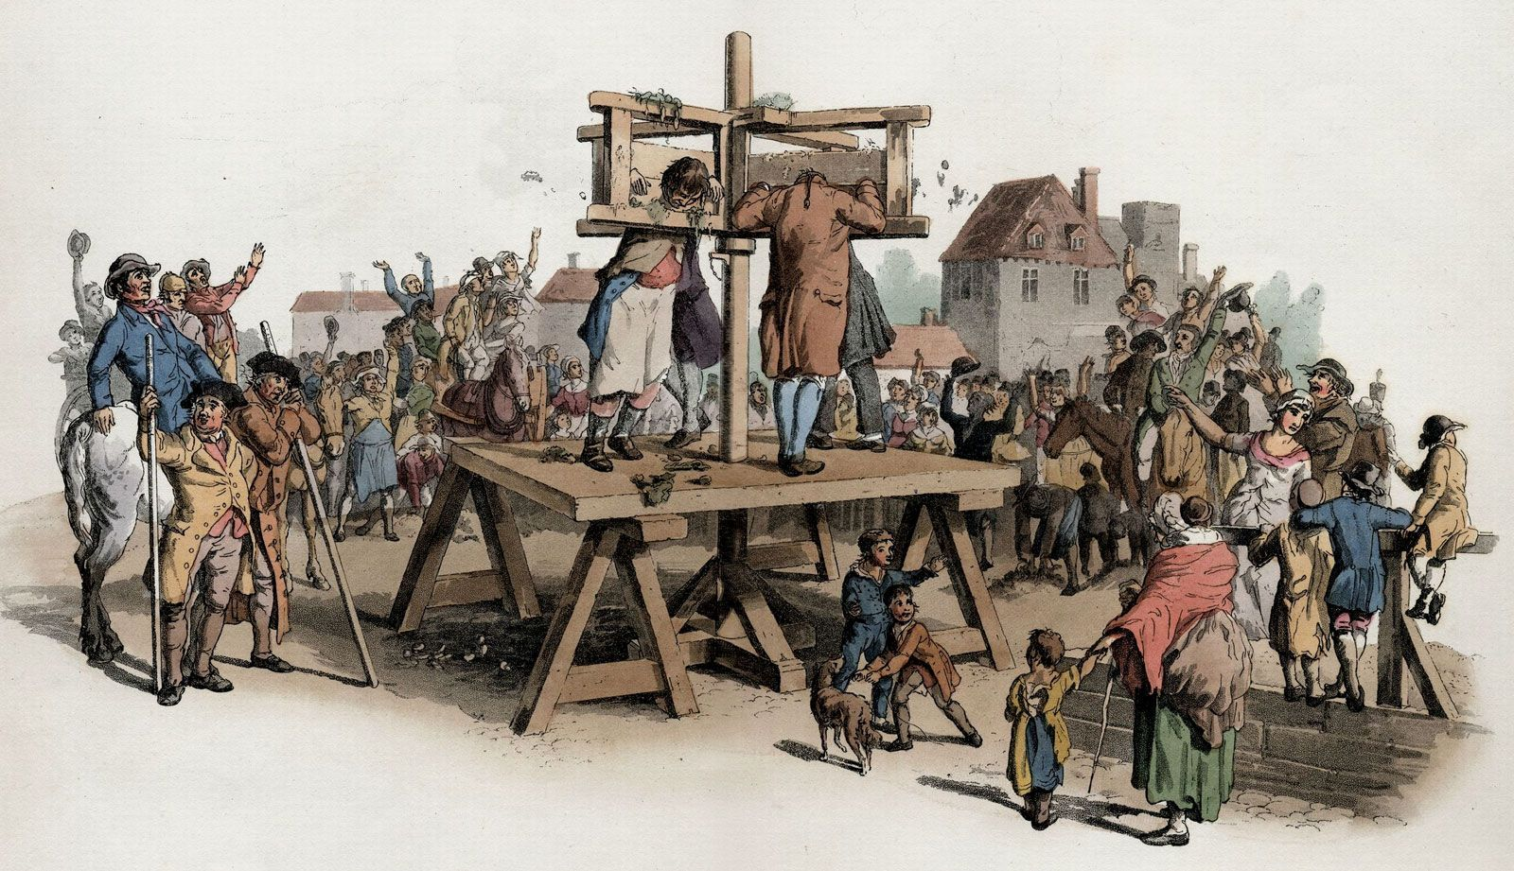
Let’s Play…
Guess the Medieval punishment!

Slide 2
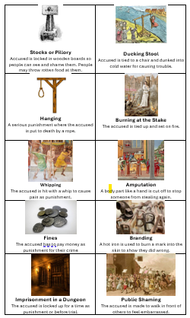
Tom the Farmer stole a chicken from the market.
Which punishment do you think was given?
Choose from your sheet.

Slide 3
Tom the Farmer stole a chicken from the market.
ANSWER:
Whipping or Stocks or pillory (both were used for petty theft)

Slide 4
Alice was caught gossiping and spreading lies about her neighbour.
Which punishment do you think was given?
Choose from your sheet.

Slide 5
Alice was caught gossiping and spreading lies about her neighbour.
ANSWER: Ducking Stool

Slide 6
William murdered another man during a fight over land.
Which punishment do you think was given?
Choose from your sheet.

Slide 7
William murdered another man during a fight over land.
ANSWER: Hanging.

Slide 8
Sarah was accused of being a witch by her village.
Which punishment do you think was given?
Choose from your sheet.

Slide 9
Sarah was accused of being a witch by her village.
ANSWER: Burning at the Stake.

Slide 10
Jack, a poor man with no job, was caught begging in the town.
Which punishment do you think was given?
Choose from your sheet.

Slide 11
Jack, a poor man with no job, was caught begging in the town.
Which punishment do you think was given?
Choose from your sheet.

Slide 12
Jack, a poor man with no job, was caught begging in the town.
ANSWER: Whipping or fines.

Slide 13
Emma was found to be poaching deer on the lord’s land.
Which punishment do you think was given?
Choose from your sheet.

Slide 14
Emma was found to be poaching deer on the lord’s land.
ANSWER: Amputation or Hanging – poaching was a serious crime!

Slide 15
Luke refused to go to church and spoke out against the Church.
Which punishment do you think was given?
Choose from your sheet.

Slide 16
Luke refused to go to church and spoke out against the Church.
ANSWER: Burning at the stake.

Slide 17
Megan broke into a merchant’s house and stole silver coins.
Which punishment do you think was given?
Choose from your sheet.

Slide 18
Megan broke into a merchant’s house and stole silver coins.
ANSWER: Hanging – burglary was seen as a very serious crime!

Slide 19
Henry, a servant, ran away from his master without permission.
Which punishment do you think was given?
Choose from your sheet.

Slide 20
Henry, a servant, ran away from his master without permission.
ANSWER: Public shaming.

Slide 21
Lilly lied in court while giving evidence about a neighbour.
Which punishment do you think was given?
Choose from your sheet.

Slide 22
Lilly lied in court while giving evidence about a neighbour.
ANSWER: Branding.

