Slide 1
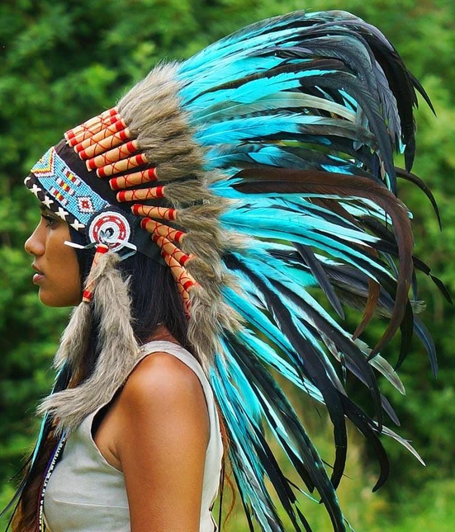
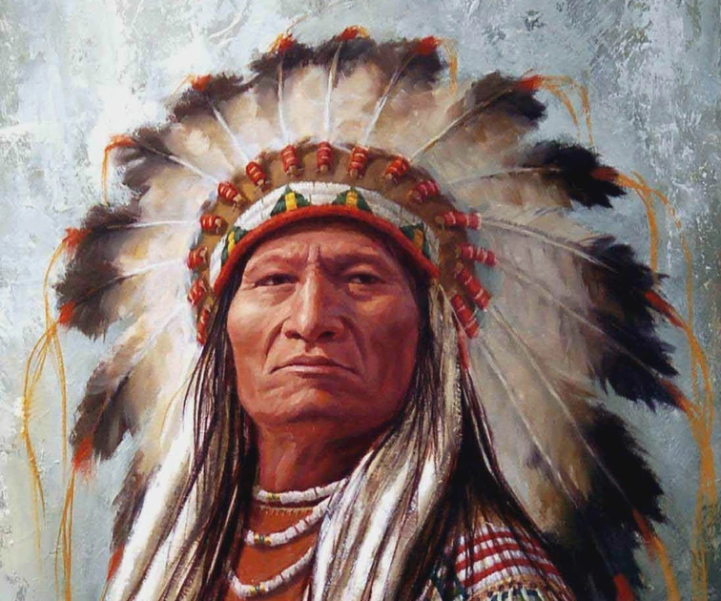
Design a feather for a Native American headdress.

Slide 2
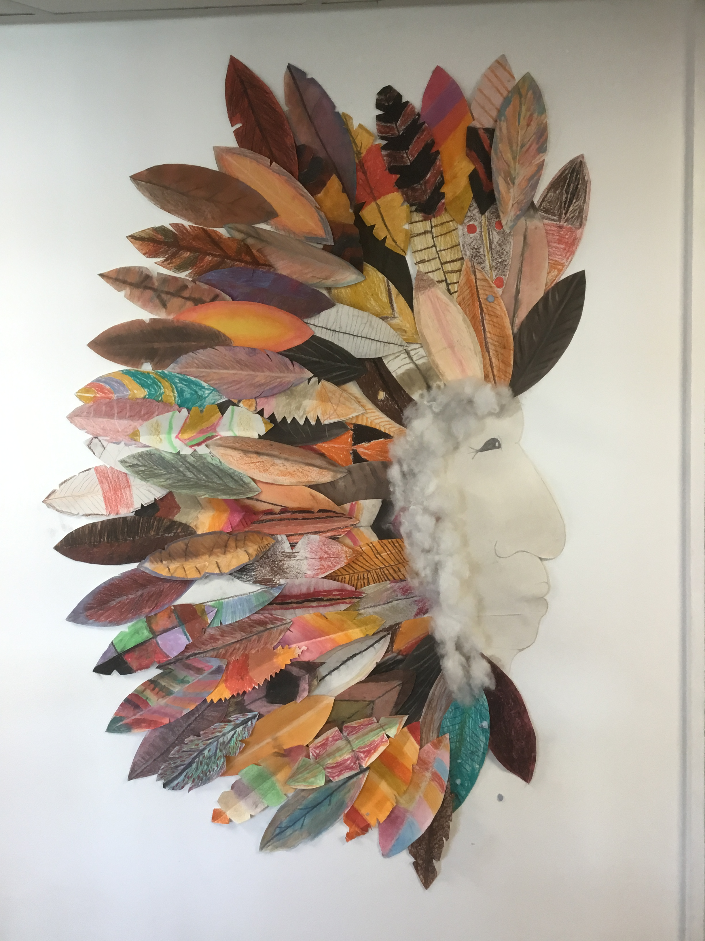
Design a feather for a Native American headdress.
How would you improve this?
Different shapes?
Different sizes?
Different colours?
You will practise designing your own feather to go on this year’s headdress.
Sketch at least 2 different designs.
(You will see some example feathers on the following pages).
You will then create your own feather using pastel crayons.

Slide 3
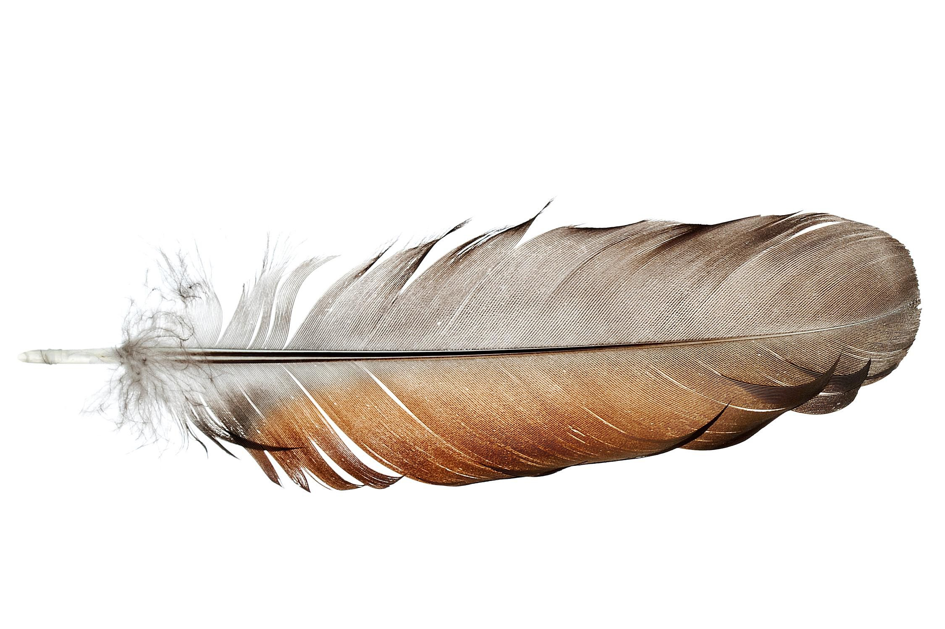

Slide 4
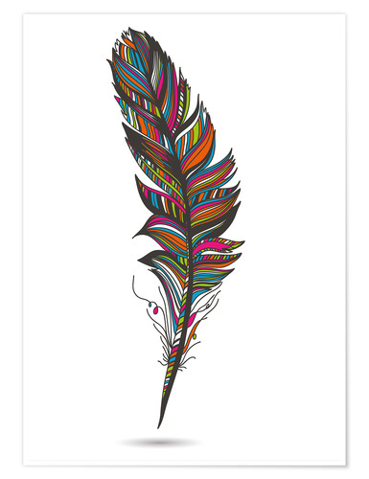

Slide 5
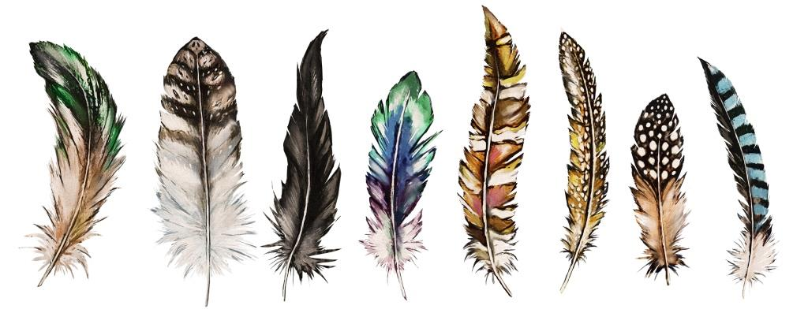

Slide 6
