Slide 1
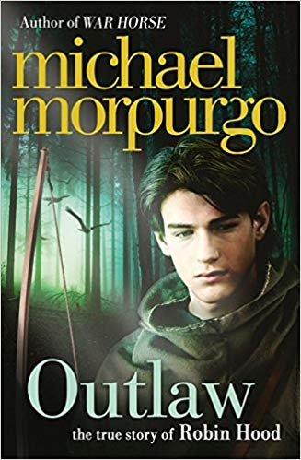
Outlaw By Michael Morpurgo.

Slide 2
Look at the front cover.
What is the book about?
What do you already know about Robin Hood?
Read Chapter 1
What words are you unfamiliar with?
What is the ‘beast’?
Have you ever witnessed a storm?
Find a picture of storm damage in a forest and add it to your BookCreator. Add words and phrases from the text and of your own to describe the picture. Also think how it would feel to be there.

Slide 3
Read Chapter 2
Who is dreaming? Who is he dreaming about? Why is this strange?
Why should they not hunt for the deer?
How did Robin feel during this chapter? Think about the range of emotions he went through.
Go to www.menti.com and add code: 75 66 29
Add the five emotions you think Robin felt most to the word cloud.
Add a photo of the word cloud to your BookCreator.

Slide 4
Read Chapter 3
What are the Outlaws?
Look up ‘gibbet’ what does it mean? Why are the crows there?
Why did they call Robin’s father Samson?
Imagine Robin’s father is given the opportunity to write a letter to Robin before he goes to be hanged. What would he want to say? Write a letter as Robin’s father to Robin in your BookCreator. Choose an old fashioned font, to make it look authentic.

Slide 5
Read Chapter 4
How did Robin manage to escape with his father?
Why was his horse so tired?
How did the outlaws help?
What is a tyrant?
Use PicCollage to create a WANTED poster for Robin that the Sheriff would display in Nottingham. Remember to include what he is wanted for, his appearance and what the reward is. You could draw a picture or find a suitable one online. Add the poster to your BookCreator.

Slide 6
Read Chapter 5
Answer the questions below verbally using voice recorder in BookCreator.
Why would Guy of Gisbourne and the soldiers not venture into the forest?
Who wanted Robin Hood dead or alive?
What was the reward for Robin Hood?
Where did Robin Hood go when he wanted to be alone?
What did the Outlaws do to help Robin Hood?
What were the Outaws doing whilst they were lying low?
Why did Robin go down to the river?
What were the Outlaw’s golden rules?

Slide 7
Read Chapter 6
Who are the new characters?
What have they brought to the Outlaws?
What do you think will happen next?

Slide 8
Read Chapter 7
This is an exciting chapter with lots of action!
Why did Robin not kill the Sheriff?
Why do you think the battle after Robin wins the contest is not described in detail? Roughly how many people are killed?
What is Sir Guy’s new plan?
Read pages 113-118 again.
In your group create four freeze frames for the parts below. Take a photo of each freeze frame and use mark up in photos to edit your photo and add thought bubbles to the characters.
Outlaws staring at the Sheriff p113.
Sheriff being presented to Robin p116.
Robin raising his sword p117.
The supper p118.
Now put your photos into comic heads.

Slide 9
Read Chapter 9
Read Chapter 9. Are there any words which you do not know the meaning of? Make a note of them.
Go to menti.com and enter code 33 45 69
Enter a maximum of 5 words you find unfamiliar. Make sure you spell them correctly. Take a photo of the word cloud and add it to your BookCreator.
Now use your iPad to find the meaning of the words. Use BookCreator to make a word and definition matching game for a friend to play.

