Slide 2
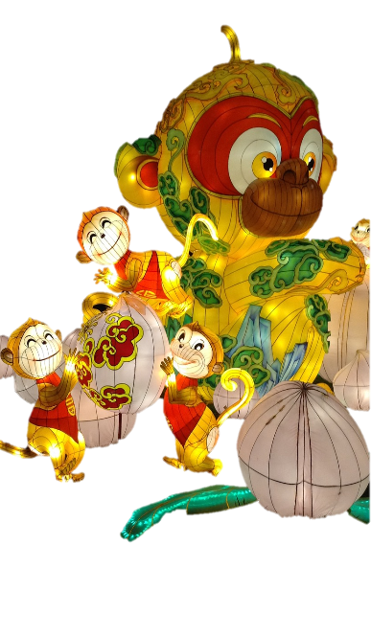
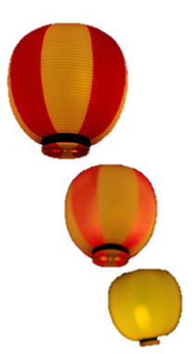
What Is the Lantern Festival?
The Lantern Festival is not, as some think, Chinese New Year. It actually signifies the end of the Spring Festival (Chinese New Year), the most important festival in the Chinese calendar.
The Chinese name for the Lantern Festival is 元宵节 or Yuánxiāojié, which is pronounced: “ywen-sshyaoww jyeah”.
It means ‘First Night Festival’.
Photo courtesy of Tam Tam (@flickr.com) - granted under creative commons licence – attribution

Slide 3
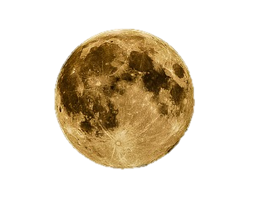
When Is the Lantern Festival?
The Lantern Festival falls on the fifteenth day of the first lunar month. This means that the festival will always be between 5th February and 7th March.
A lunar month is the time it takes for the Moon to orbit the Earth.

Slide 4
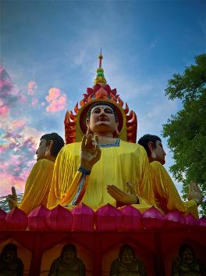
When Did It Start?
Over 2000 years ago, Emperor Hanmingdi of the Easter Han Dynasty (AD25 - AD75) first celebrated the Lantern Festival.
Buddhists would light lanterns on the fifteenth day of the first lunar month to show respect for Buddha.
Because he respected Buddhism, Emperor Hanmingdi ordered that lanterns be lit in houses and temples on this night.
Photo courtesy of Tom Thurman (@flickr.com) - granted under creative commons licence – attribution

Slide 5
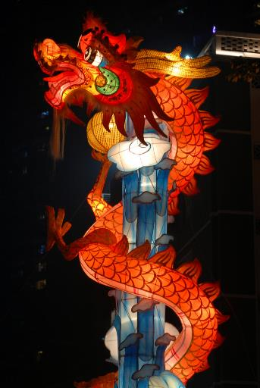
What Happens?
The lanterns are the star of the show at the Lantern Festival and come in all guises including floating and flying lanterns.
Many are decorated with patterns, pictures and even riddles.
There are also traditional dragon dances.
People wish each other a ‘Happy Lantern Festival!’
元宵节快乐！or Yuánxiāojié kuàilè!
Pronounced: “ywen-sshyaoww-jyeah kwhy-luh”
Photo courtesy of Percy Chen (@flickr.com) - granted under creative commons licence – attribution

Slide 6
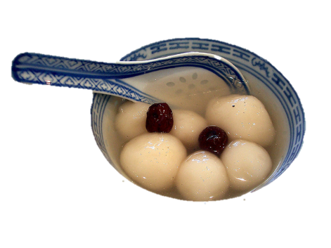
Other Traditions
During the Lantern Festival, an important custom is eating round dumplings called tangyuan (pronounced: tung-ywen).
The dumplings are made of rice flour with sweet fillings, such as sugar, walnuts, rose petals or bean paste.
They can be cooked by boiling, frying or steaming.
The dumplings are served in a bowl of rice soup called tianjiu (pronounced: tyen-jyoh).
Photo courtesy of Alpha (@flickr.com) - granted under creative commons licence – attribution

Slide 7
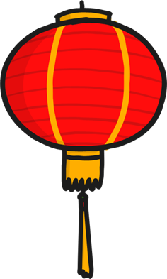
Happy Lantern Festival!
元宵节快乐！

