Slide 1
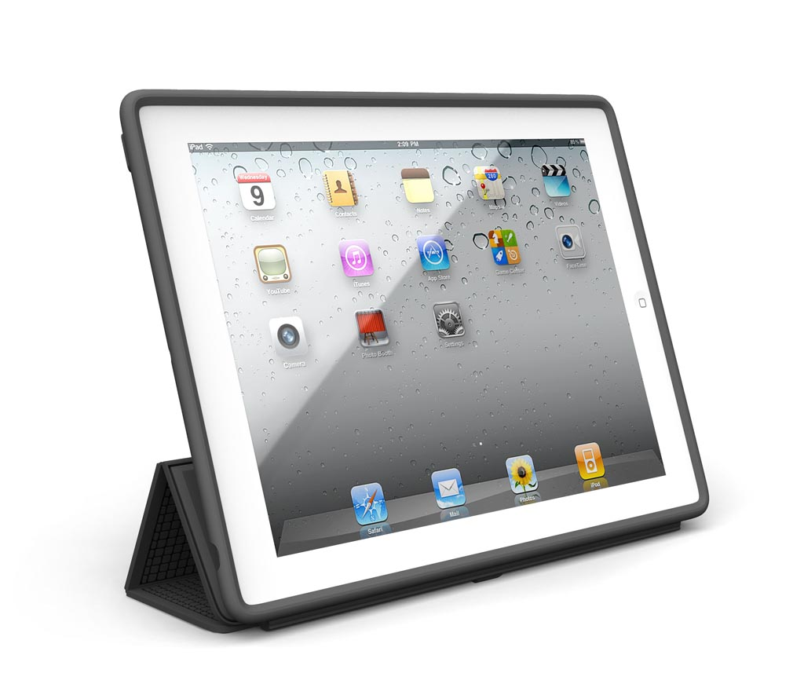
Using my iPad responsibly
This Photo by Unknown Author is licensed under CC BY-SA-NC

Slide 2
I will always keep my iPad away from food or liquid
This Photo by Unknown Author is licensed under CC BY-SA-NC

Slide 3
I will always use two hands to hold my iPad
This Photo by Unknown Author is licensed under CC BY-NC

Slide 4
I will always keep my iPad in its case
This Photo by Unknown Author is licensed under CC BY-SA-NC

Slide 5
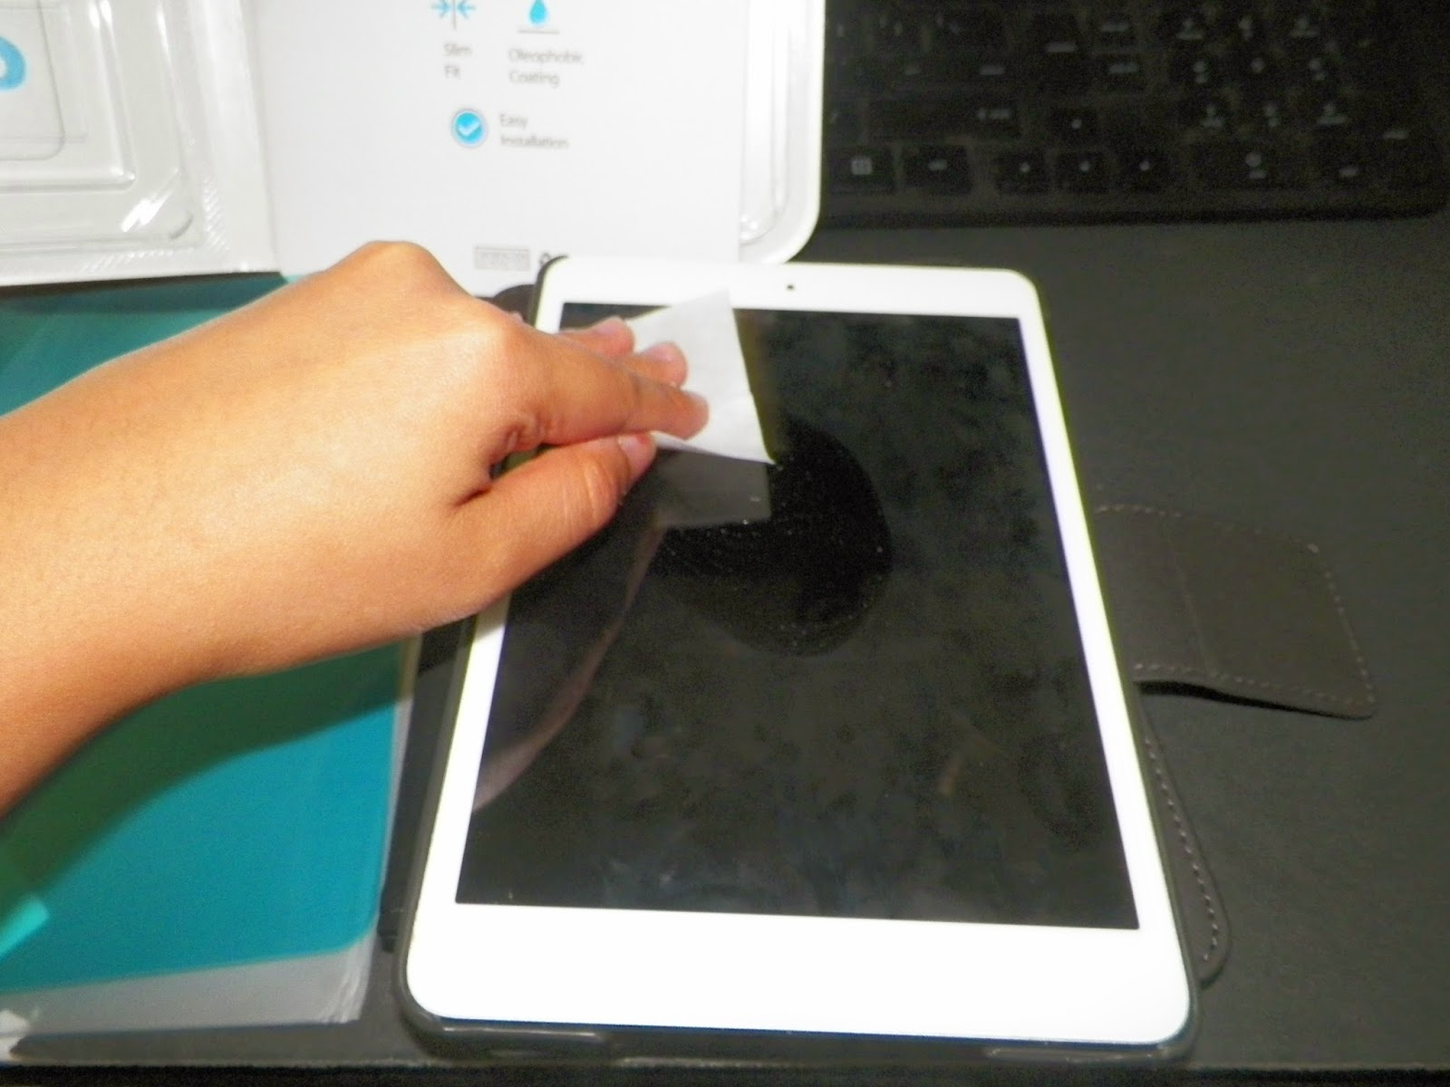
I will clean my iPad every day with a wipe I will make sure my hands are clean before using it
This Photo by Unknown Author is licensed under CC BY
This Photo by Unknown Author is licensed under CC BY-SA

Slide 6
I will only use the apps my teacher asks me to use
This Photo by Unknown Author is licensed under CC BY-SA

Slide 7
I will respect others and put my iPad down when a teacher is talking to me
This Photo by Unknown Author is licensed under CC BY-NC-ND

Slide 8
Y4-6 I will bring my iPad to school every day and make sure it is charged
This Photo by Unknown Author is licensed under CC BY-SA-NC

Slide 9
I will treat my iPad with care and make sure that I know where my iPad is when I am responsible for it
This Photo by Unknown Author is licensed under CC BY-SA

Slide 10
I will only take pictures or record sounds when a teacher asks me to
This Photo by Unknown Author is licensed under CC BY-SA
This Photo by Unknown Author is licensed under CC BY-SA

