Slide 1
Ms teams
Part of Office 365

Slide 2
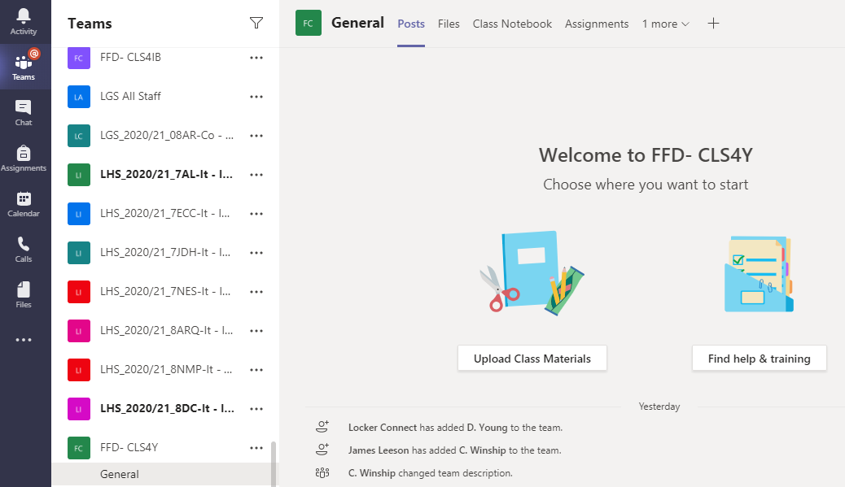

Slide 3
Ms teams
Overview – the functionality
What you will see when you turn on your PC
How we can use teams for Teaching
How to set up your lessons

Slide 4
Overview: How to access teams
All computers have Teams installed
Log in with your school email and password.
All your Teams (classes) are created automatically from Sims for example 4IB is Ian’s class
Science and ML will be created manually
All Teams have within them channels, and ALL Teams have just one to start with –General (demo) think of a channel as a sub group.

Slide 5
1. Activate your team
You will be the owner of your Team and the first thing you will need to do is Activate the Team. Once this is done the pupils will be able to see the Team.
You can do this through email or you can do this through the Team itself (Video link)

Slide 6
2. Check your team members
Once you have activated your Team you will need to check that all the pupils are there. If they are missing you can manually add them.
You can also add a member of staff if you share a class. (Video link)

Slide 7
3.1 Adding channels
As part of your Class structure you will need to add all the subjects as channels
Click the 3 dots next to your Team
Add Channel
Name with the subject
Make visible for the children
Save
Help Video
You will also need to add all the subject specialists to your Class (Team) so that they can schedule their lessons through their channel in your class (Martine via the Science channel etc)

Slide 8
3. How to schedule a lesson
Go
Go to the calendar
Go
Go to where your lesson is
Click
Click add channel of the Team – this adds it to the calendar and you can then schedule it to repeat weekly until the end of the Year.
Save and send
Save and send, this adds it to your calendar and to the calendar of the children
Video
(Video link)

Slide 9
3.1 steps to schedule a lesson
1. Add a title
2.Add the lesson time
3. Add in the repeat option weekly for the year if required (through the custom option)
4. Add the class using the channel option
5. Add a description
6. Save and Send
7. This adds it to your calendar and the calendar of the children
8. The children join by clicking join at the time of the lesson.

Slide 10
4. Starting The lesson
1. Change the settings so that the children are attendees. (link)
2. At the time of the lesson click join this starts the lesson
3. Make sure your video is on and the mic is on!
4. keep an eye on who has joined the lesson so you can potentially take a register
5. Ask the children to turn their camera off
6. Once the children have joined you are good to go!

Slide 11
5. Teaching the lesson
With Teams it is possible to share your screen. To make it easier have open on your computer any resources that you may want to share.
A Firefly page
Documents
PowerPoints
How to share your screen (video clip)
During the lesson pupils can use the raise your hand feature and also the chat function

Slide 12
recap
Activate your Team (link)
Check the members (Link)
Schedule your lessons (link)
Have a go at sharing your screen even if it is with your work colleagues!
Add subject channels and subject specialsts to your class (team) (link)
Change permissions of your lesson (link)

Slide 13
Intellinet
The content from Intellinet will be moved to Teams
This will be done in a staged process
There will be a new Dashboard which will be the landing page when you log onto the computers
This will have the links for all systems like firefly, CPOMS, email, OneDrive etc
This should be in place in the second half of this term.

Slide 14
