Slide 2
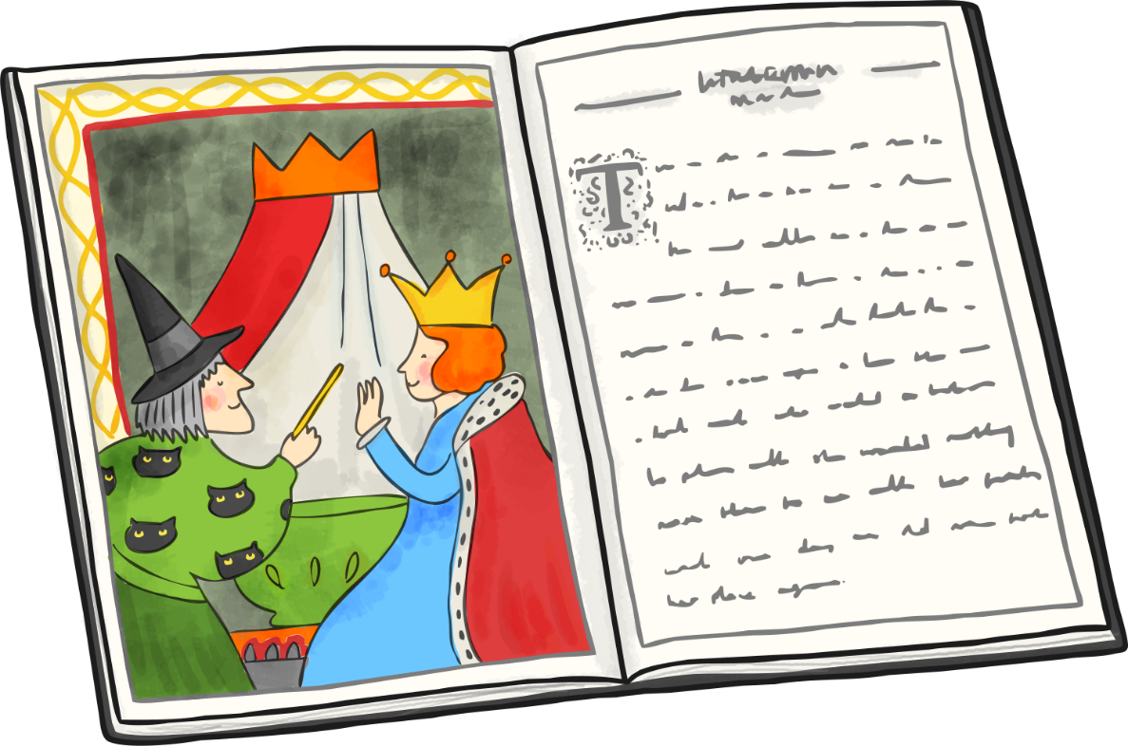
Story Openers
LO: To select and use appropriate openers in narrative writing.

Slide 3
Story Openers
Story openers help to set the tone for the rest of our writing.
A good opening makes the reader want
to read on.
A good opening tantalises the reader with an idea of who, where, when or what is happening (or is going to happen).

Slide 4
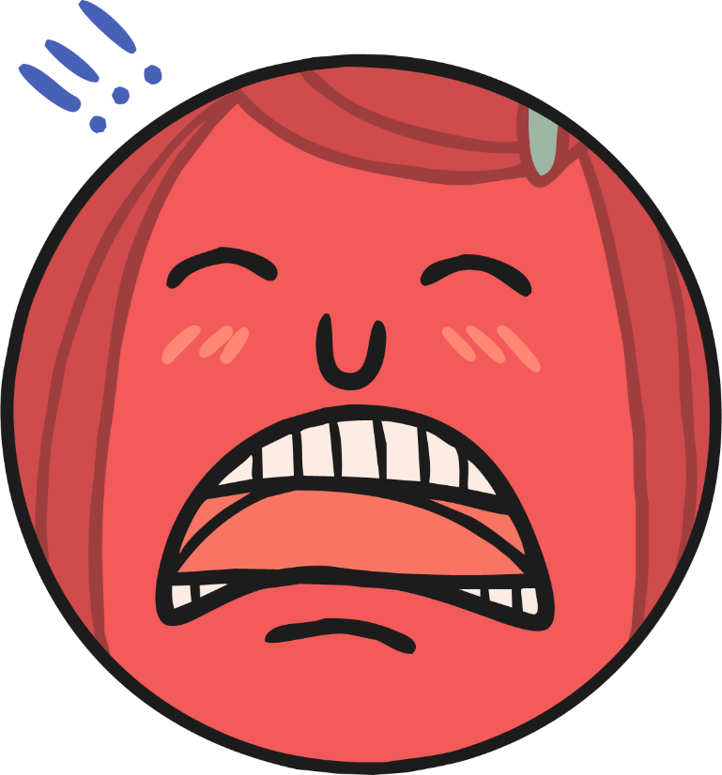
Story Openers
Stories can open with a character description.
‘Mr Stink stank. He also stunk’.
from Mr Stink by David Walliams

Slide 5
Story Openers
Stories can open with a description of a setting.
‘There was once a gaggle of
mountains, tall and proud,
each with a hat of snow.’
from Stone Goblins,
by David Melling

Slide 6
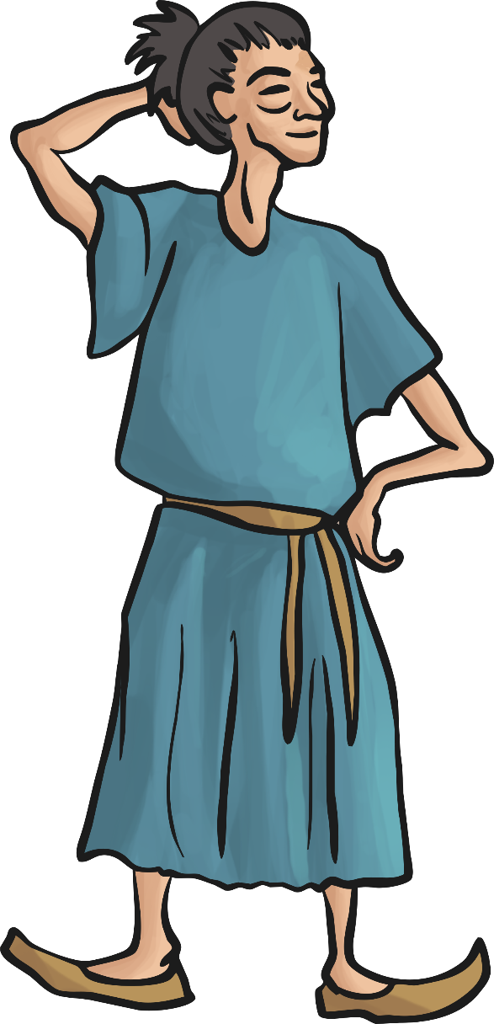
Story Openers
Stories can open with a description of both a character and a setting.
‘A thousand miles ago, in a country east of the
jungle and south of the mountains, there lived
a Firework-Maker called Lalchand…..’
From The Firework-Maker’s Daughter by Phillip Pullman

Slide 7
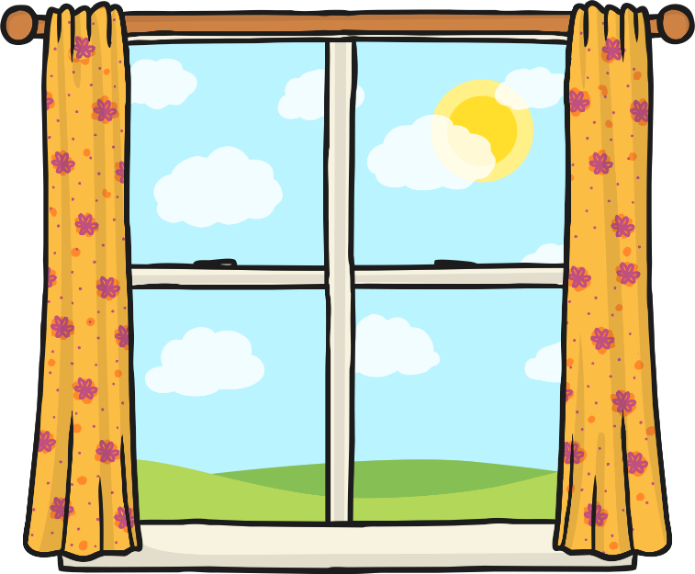
Story Openers
Stories can open with dialogue.
‘Molllly!’ Maria shouted to her sister.
‘Would you please shut that window….’
from School for Stars: Second Term
at L’Etoile by Holly and Kelly Willoughby

Slide 8
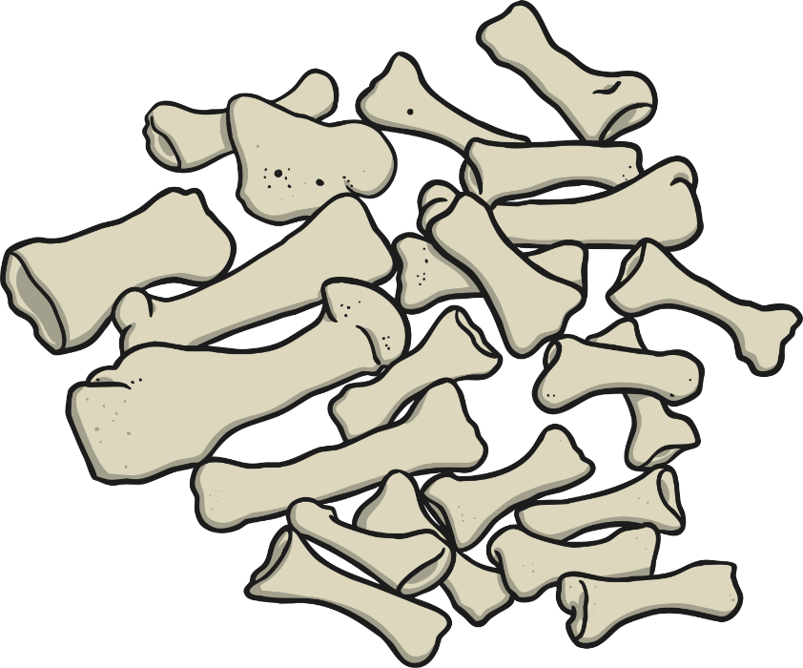
Story Openers
Stories can open with action.
‘Jesse was always finding bones in
the great bog-oak field where they
dug the peat for the winter fires.’
from The Ghost of Grania O’Malley
by Michael Morpurgo

Slide 9
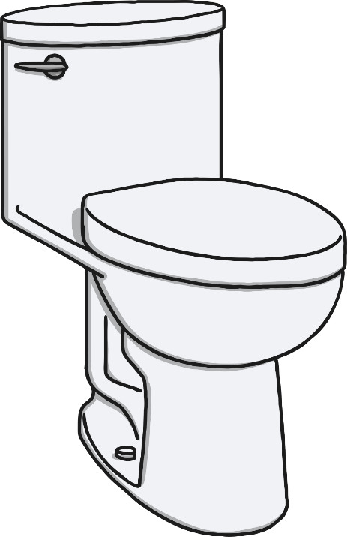
Story Openers
Stories can open with a question.
Good openers sometimes leave the reader with an unanswered question, which can only be answered by reading on.
‘Ever had the feeling your life’s been flushed
down the toilet?’
From The Toilet of Doom by Michael Lawrence

Slide 10
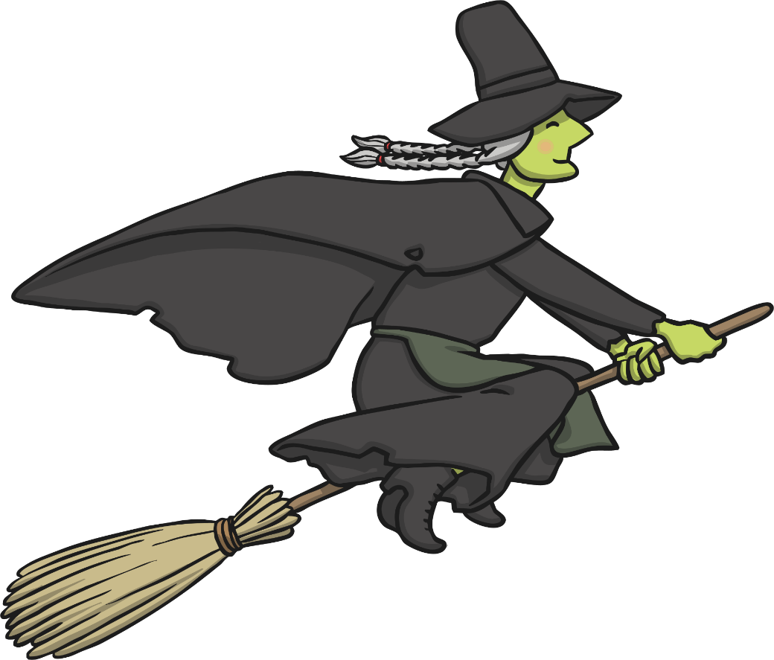
Story Openers
Stories can open with a statement.
‘In fairy tales, witches always
wear silly black hats and black
cloaks, and they ride on broomsticks.’
from The Witches, by Roald Dahl

Slide 11
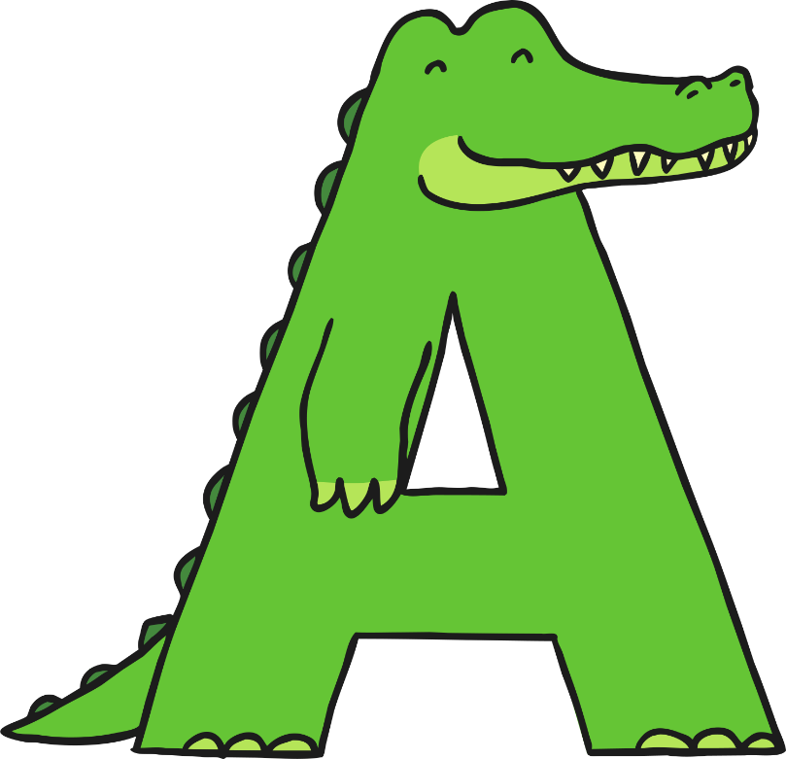
Story Openers
Stories can open with a fronted adverbial.
‘Ages ago, Alex, Allen and Alva
arrived at Antibes…’
From Alphabetical Africa by Walter Abish

