Slide 1
Learning objective:
week 5
To learn some basic greetings.

Slide 2
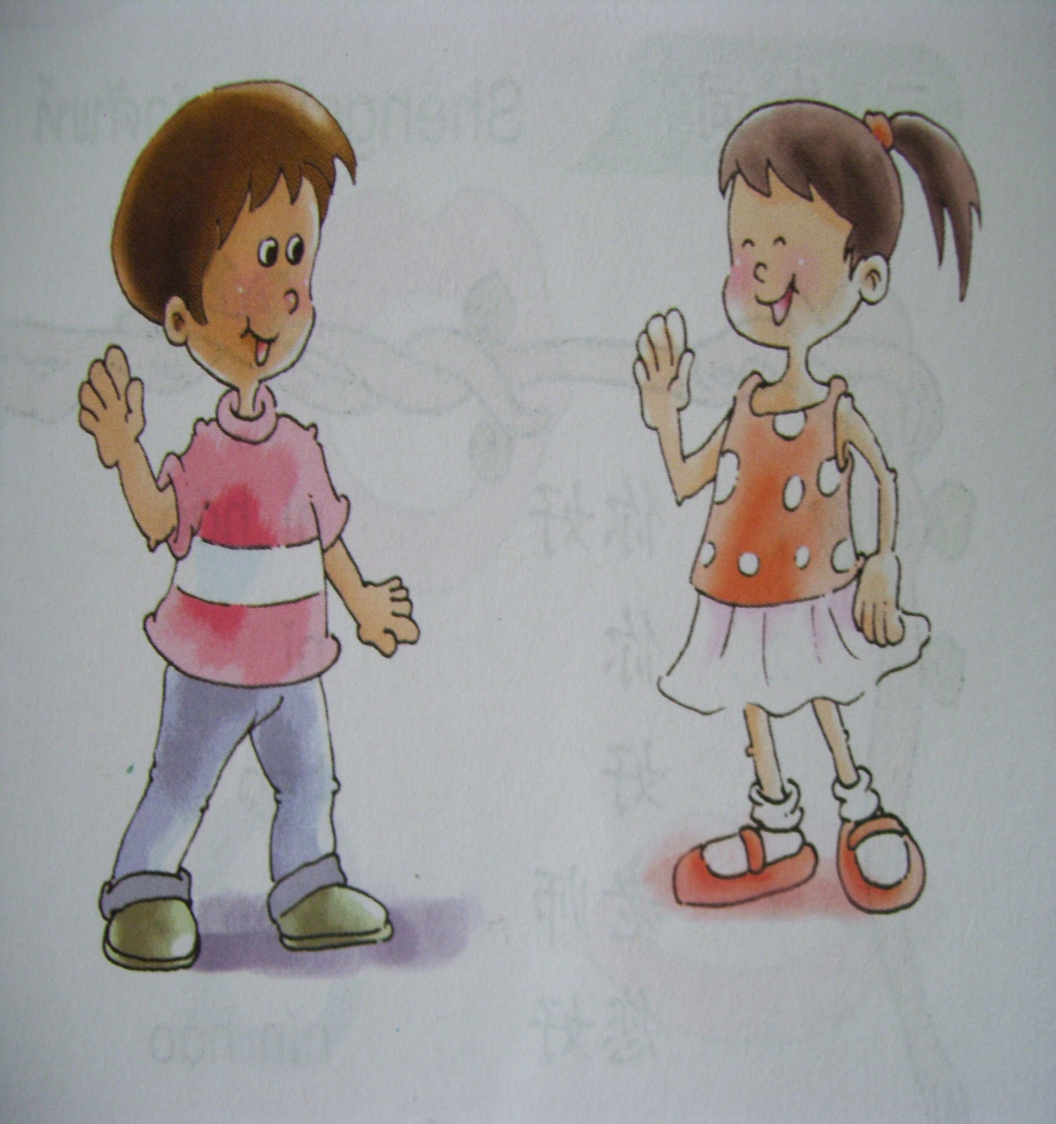
Guess: What are they saying?

Slide 3
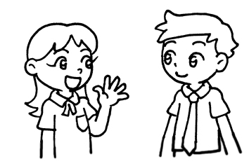
Nǐ hǎo!
你好！
Nǐ hǎo!
你好！

Slide 4
Now,
greet
your
classmates.
Nǐ hǎo.
你好。
Hello.

Slide 5
nín
您
你
心
Nín hǎo！
您好！

Slide 6
What do we learn today
Summary
?
Nǐ hǎo.
你好。
Hello.

Slide 7
Lesson 2,

