Slide 1
Sikhi: The Five Ks

Slide 2
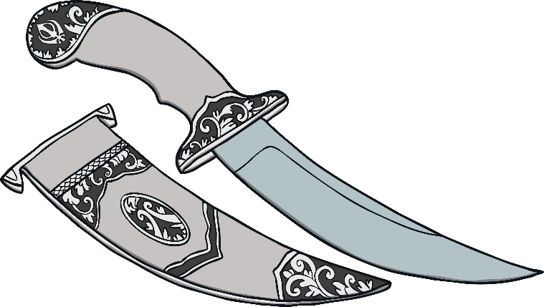
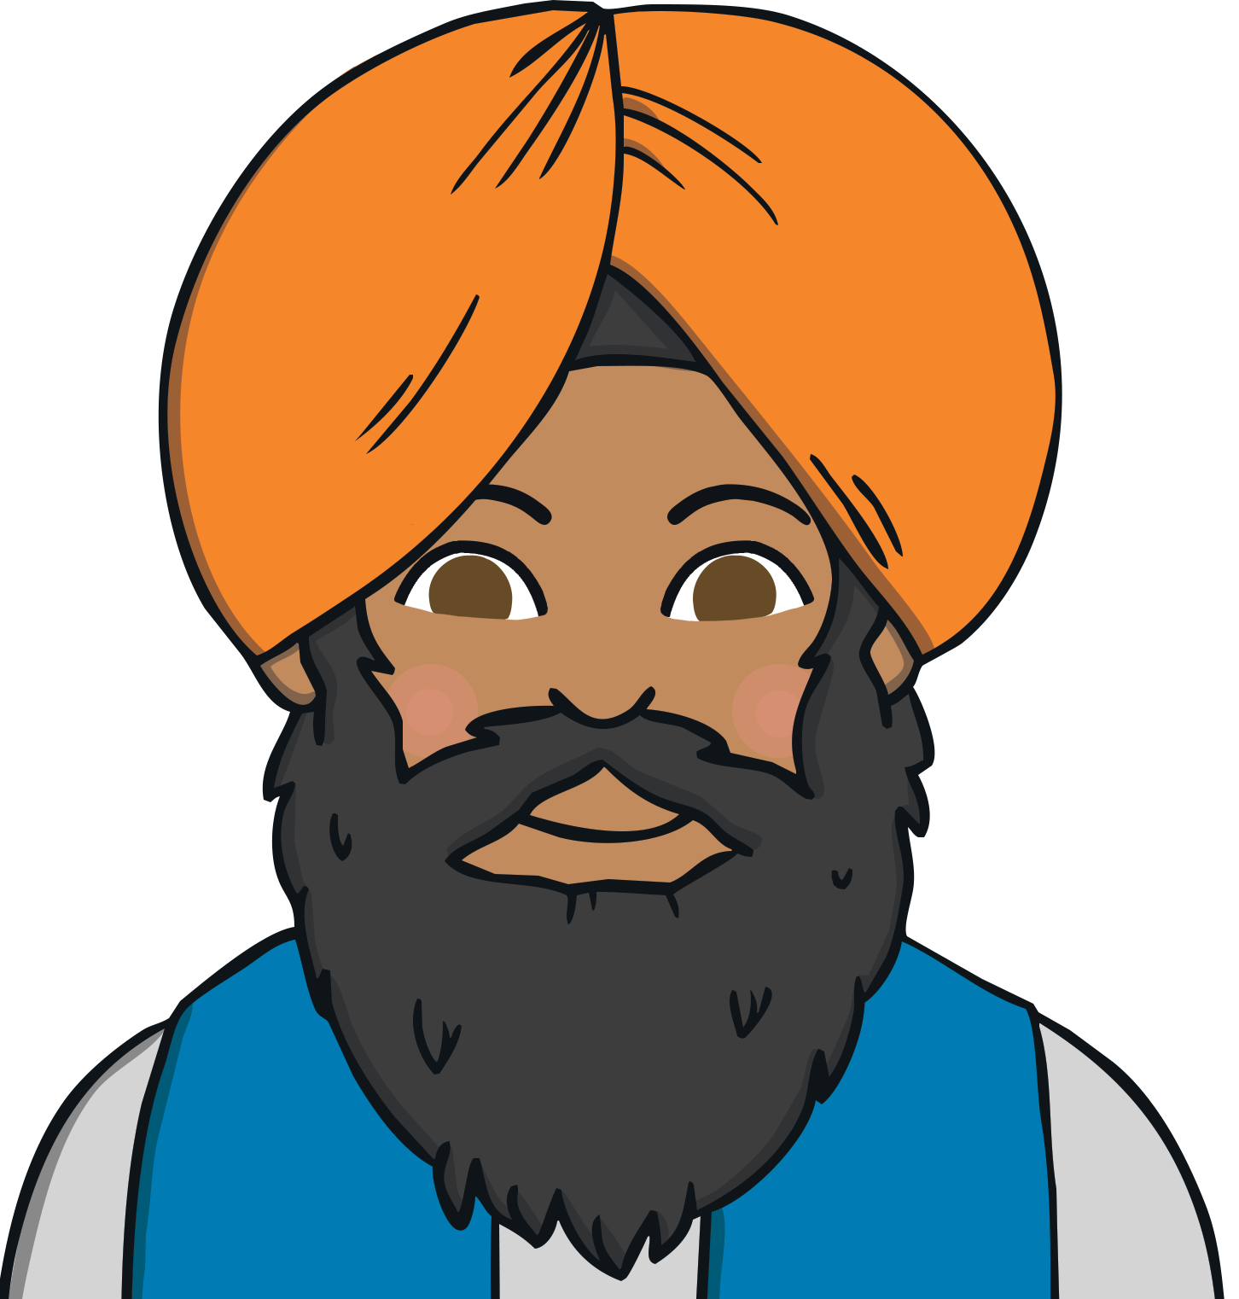
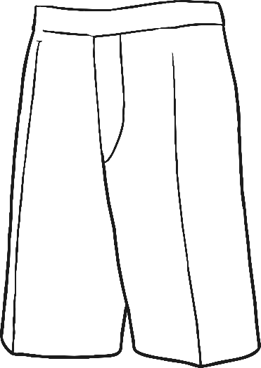
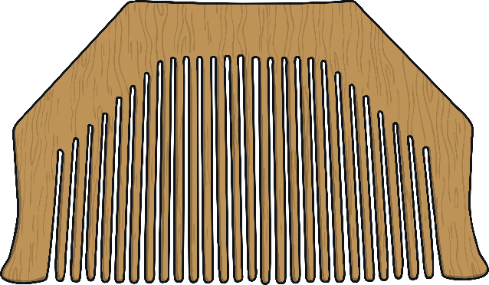
The Five Ks
All men and women who belong to the Khalsa must wear five symbols which shows they are Sikh.
They are called the five Ks because in Panjabi their names all begin with the letter ‘K’.
Panjabi: The official language of the Indian state of Punjab.

Slide 3
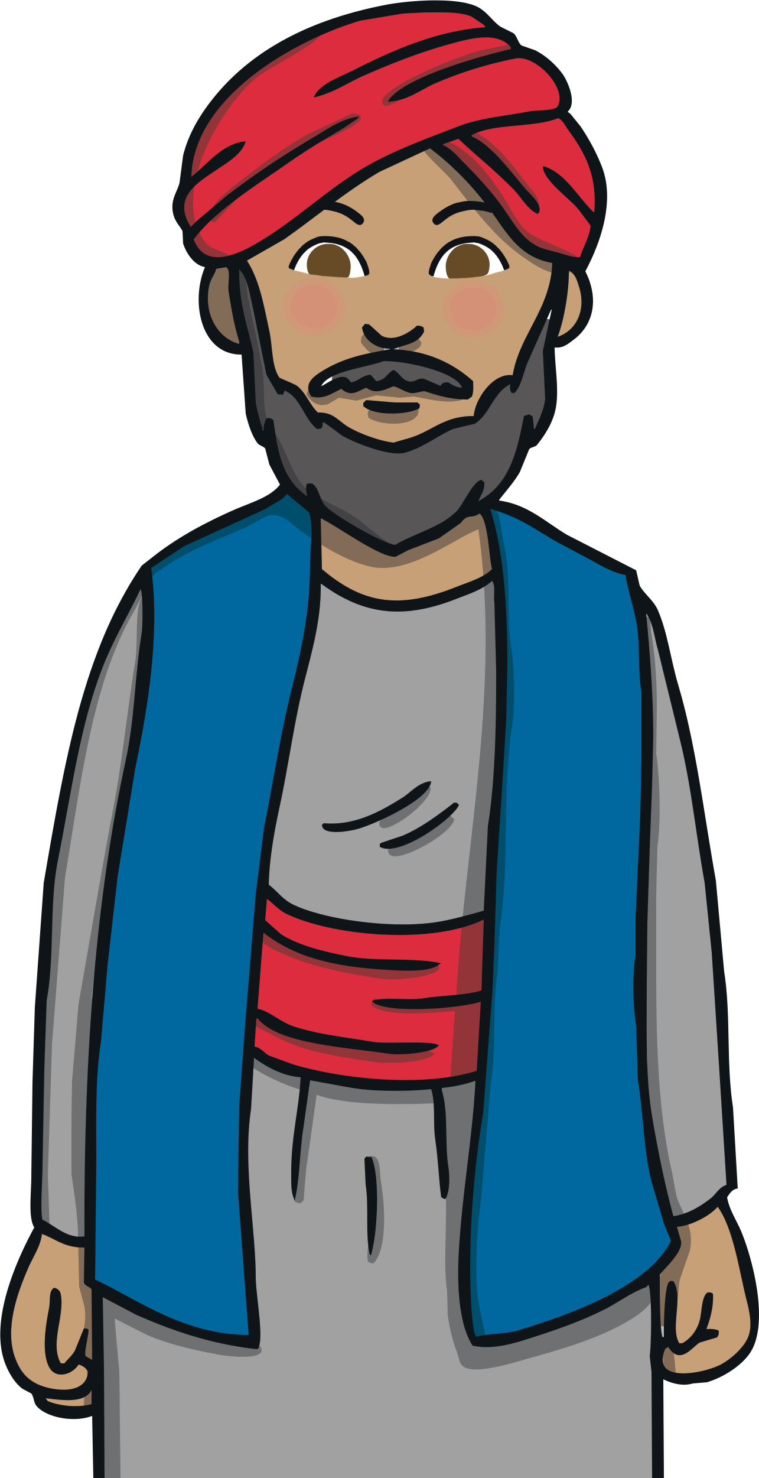
Kesh
Kesh means hair.
Sikhs make a promise to not cut their hair but let it grow as a symbol of their faith.
Sikhs’ hair gets very long during their life so they wear a turban to keep it tidy.
They believe this demonstrates their obedience to God.

Slide 4
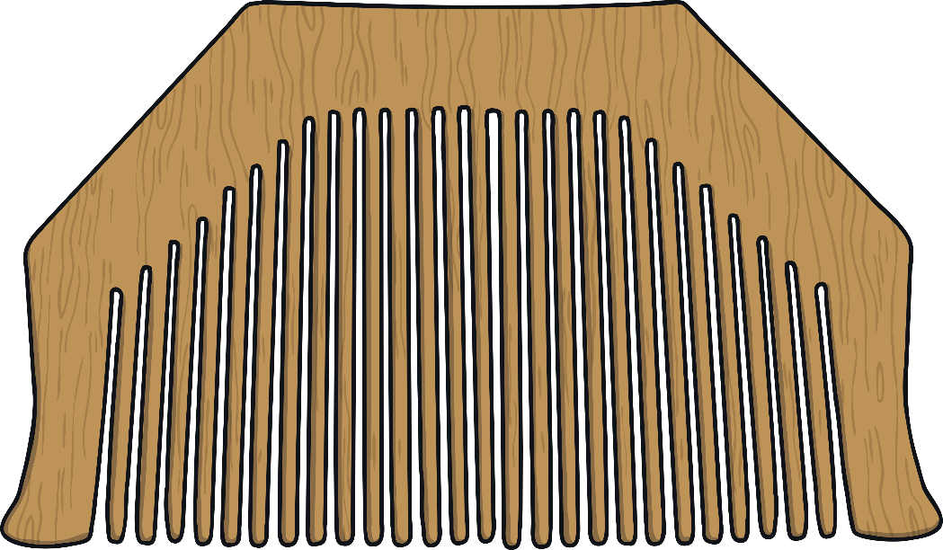
Kangha
The Kangha is a small wooden comb.
Sikhs use this to keep their hair in place and it is a symbol of cleanliness.
Combing their hair reminds Sikhs that their lives should be tidy and organised.

Slide 5
The Kara
The Kara is a steel bangle worn on the arm of Sikhs.
It is a continuous circle with no beginning and no end which represents God.
It reminds Sikhs to behave well, follow their faith and restrain from doing wrong.

Slide 6
The Kachera
The Kachera are short trousers worn as underwear. These are more practical than the long, loose clothes most people in India wore at the time of Guru Gobind Singh Sahib Ji.
They are a symbol of leaving old ideas behind and following new, better ones.

Slide 7
The Kirpan
The Kirpan is a warrior's sword. These days a small, blunt one is worn as a symbol of dignity and self-respect.
It reminds Sikhs that they must fight a spiritual battle, defending what is right and upholding the truth.
The last two of the five Ks, the Kachera and the Kirpan, are a reminder that Sikhs are warriors and should always fight for what is right.

