Slide 1
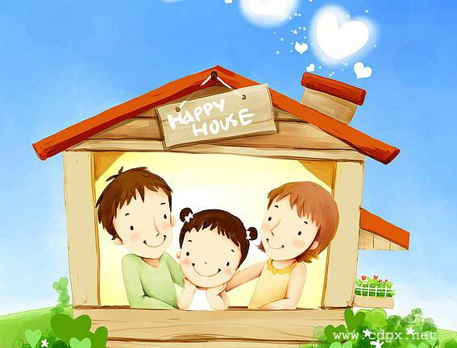
Lesson 12
jiā
家
family
rén
人
members

Slide 2
Learning objectives:
To talk about the family.

Slide 3
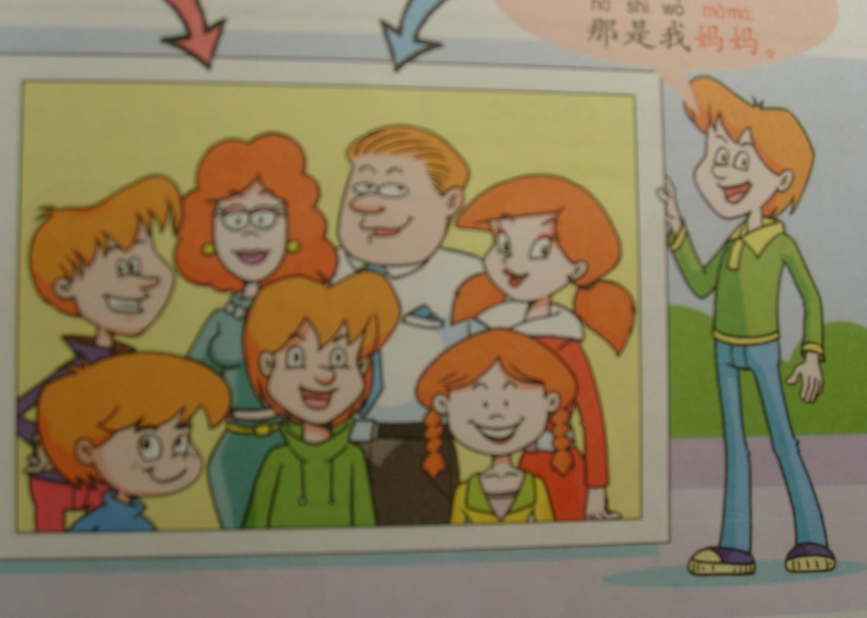
Let’s look at this photo:

Slide 4
Memory Game

Slide 5
wǒ 我

Slide 6
bà bɑ 爸爸

Slide 7
mā mɑ 妈妈

Slide 8
ɡē ɡe 哥哥

Slide 9
jiě jie 姐姐

Slide 10
dì di 弟弟
younger brother

Slide 11
mèi mei 妹妹
younger sister

Slide 12
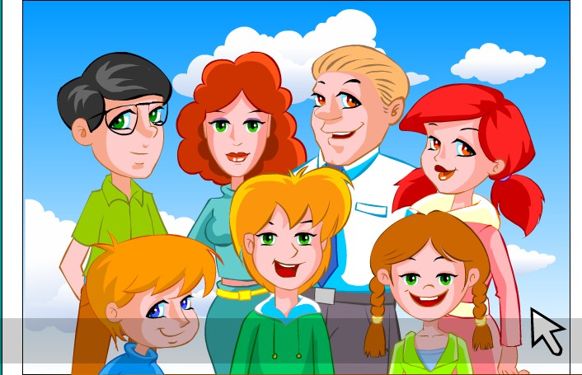
māma
妈妈
bàba
爸爸
jiě jie
姐姐
ɡē ɡe
哥哥
dì di弟弟
我
mèi mei妹妹

Slide 13
Match Up
哥哥
姐姐
妈妈
妹妹
弟弟
爸爸
Father
Mother
Older brother
Younger brother
Older sister
Younger sister

Slide 14
哥哥
Created by Sheautian Tan

Slide 15
妹妹
Created by Sheautian Tan

Slide 16
妈妈
Created by Sheautian Tan

Slide 17
姐姐
Created by Sheautian Tan

Slide 18
弟弟
Created by Sheautian Tan

Slide 19
爸爸
Created by Sheautian Tan

Slide 20
New words
hé
和
and

Slide 21
____ 和 ____

Slide 22
Sentence pattern:
yǒu méi yǒu
有 / 没有
to have not to have
我+有/没有 + family members
Notes:
22

Slide 23
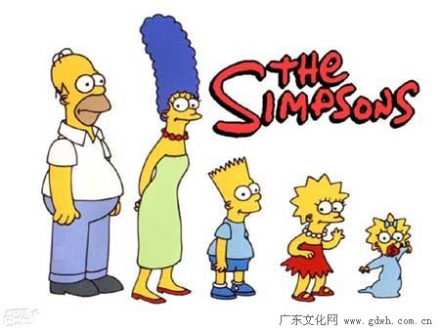
Practice
我
Example:
我有爸爸。 I have a father.
我没有弟弟。I haven’t any brothers.

Slide 24
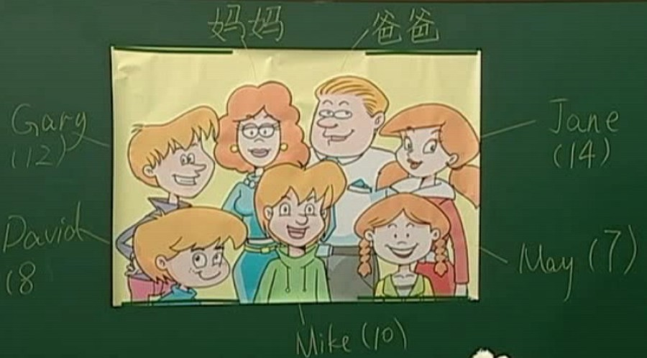
Role Game
我是______ 。
我有______(和)______ 。
我没有____(和)______ 。

Slide 25
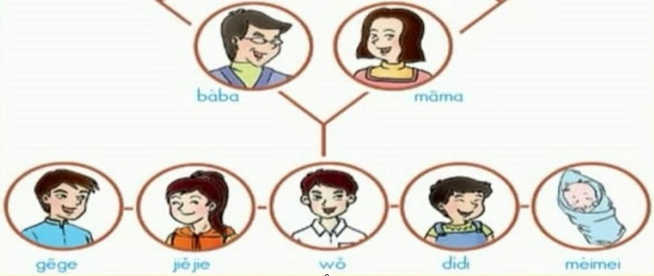
作业 Homework
Make your own family tree in Chinese.

Slide 26
下课！再见！

