Slide 1
2.2: 我的小猫 wǒ de xiǎo māo
Institute of Education
IOE Confucius Institute for Schools
以
前
学
过
的
汉
字
My little cat
Jinbu 1
Chapter 2, Unit 2
In this lesson, you will learn new vocabulary for different pets
Adapted from lessons donated by colleagues at Dartford Grammar School
dì
gē
jiě
mèi
Can you add the English? Can you use them in a sentence?

Slide 2
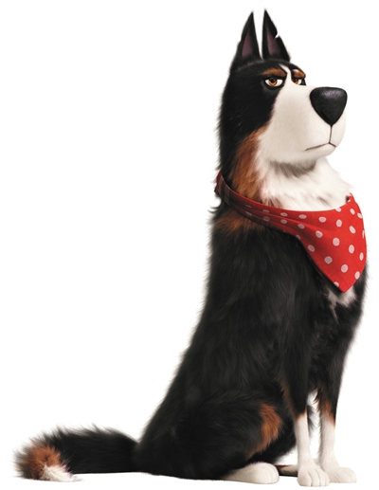
gǒu
狗
dog

Slide 3
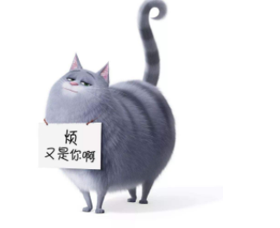
māo
猫
cat

Slide 4
yú
鱼
fish

Slide 5
niǎo
鸟
bird

Slide 6
shé
蛇
snake

Slide 7
tù zi
兔子
rabbit

Slide 9
狗

Slide 10
猫

Slide 11
鱼

Slide 12
鸟

Slide 13
蛇

Slide 14
兔子

Slide 15
Practice each character at least 5 times:
niǎo​
gǒu​
tù​zi​
shé
yú
niǎo​
Extension 1: Test your memory: cover, write, check. Extension 2: write a word that contains each character. For example, for 你, you would write 你好.

Slide 16
Can you say the word OR the whole sentence?
我有一只/条…
māo猫
gǒu狗
niăo鸟
tù zi兔子
yú鱼
shé蛇

